Slide 1


Science Network Meeting
March 26, 2015

Slide 2

Welcome
Meghan Bell
Matt Silberglitt
Kevin King

Slide 3
Agenda
History of Assessment
Balanced Assessment System
Productive Talk
AM Assessment Task Review Process
  Intent Protocol
  Learning Targets
  Success Criteria
  Modifications
PM Assessment Task Review Process
WestEd
Wrap-up and Summer Work

Slide 4
History of Assessment
How has assessment changed through the decades? (1950’s-present)
The past, present, and future of assessment.
Where are we going??

Slide 5


5
Kentucky Legislation – SB1 2009
New academic standards
New assessments
Program Reviews
New accountability
system
Improved professional
development
Unified plan
for improving college/career readiness
Notes:
It’s been three years since Senate Bill 1 became law. It really was ahead of its time and provided the roadmap for transforming public education in Kentucky – a roadmap for Unbridled Learning.
Senate Bill 1 established an aggressive readiness agenda.
Briefly, the legislation called for:
New, more rigorous academic standards aligned with college entry requirements
New assessments based on those standards
Program Reviews in Arts & Humanities, Practical Living/Career Studies and Writing, to encourage high-quality programs and plentiful student learning opportunities in these areas.
Improved professional development including strategies to support implementation of the new standards and assessment literacy, among others.
A new balanced and more relevant accountability system that holds students, teachers, principals, schools and districts accountable for progress
Developing a unified plan for improving college/career readiness in cooperation with the Council on Postsecondary Education

Slide 6

Language in SB1 2009

Slide 7
What comes to mind if you have to explain / define a Balanced Assessment System?

Slide 8
Users of the information?
Uses for the information?

Slide 10
Process the BAS Framework
Think of an assessment…
Place it on the Stiggins & Chappius assessment framework
Does the assessment serve the intended purpose based on the characteristics defined?

Slide 11

National Academies,
Board on Testing and Assessment
(BOTA) 2014

Slide 12
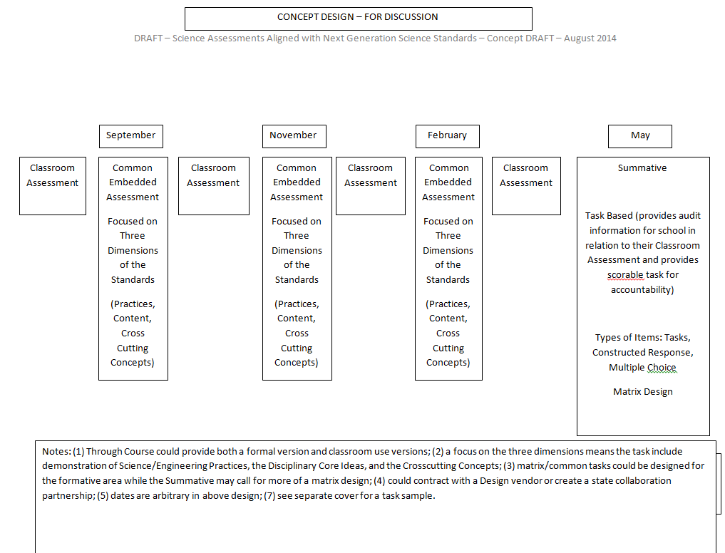
KY’s Next Gen Science Assessment System

Slide 13
KY’s Next Generation
Science Assessment System
How does this early draft compare to Stiggins & Chappuis framework for a balanced assessment system?

Slide 14
The Plan for Science Assessment*
Work is taking place to define a framework for a balanced assessment system for science.
WestEd has been selected to be the thinking partner to deliver the framework and item/test specifications based on educator input.
WestEd is NOT creating the assessments themselves – just the specs.
A new vendor will be sought to create operational assessments that meet the specifications developed.
KY teachers voices matter and are being sought to inform the specifications.
The intent is to broaden the discussion of science assessment to include the high school model, but we are starting with K-8 first.

Slide 15
The focus is building a framework for a system of assessment that begins in the classroom, focusing on generating information that enables teachers to adjust instruction and students to track their learning and focus on growth and improvement – for all levels / courses.
The process of identifying defensible evidence of student understanding goes beyond the bounds of any particular assessment.
The information the vendor will provide can be extrapolated to all science levels / courses.

Slide 16
What is being asked of teachers for developing the science assessment system?
Making formative assessment explicit,
Collecting defensible evidence of student learning & sharing with peers for review,
Informing the new assessment design from the classroom up.
Uncomfortable?

Slide 17
Productive Talk
https://www.youtube.com/watch?v=8Amu3UBj-qw
https://www.youtube.com/watch?v=WmLZyB99ITA

Slide 18


Productive Talk - Fishbowl
PE = 5-PS1-1: Develop a model to describe that matter is made of particles too small to be seen.
Context: First day of 5th grade unit on “Properties of Matter.” One hour of instruction included students using themselves as particles to model solid, liquid, gas, and dissolving.
2 days later, a writing prompt:
Create a trifold (one section each for solid, liquid, gas) with two parts: (a) create your own model for each type of matter; (b) write a description of your models.

Slide 19
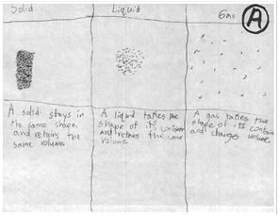
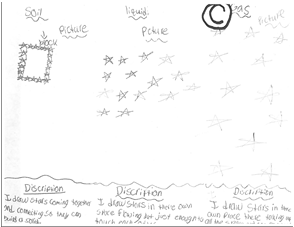
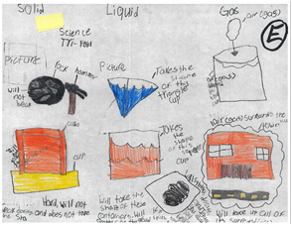
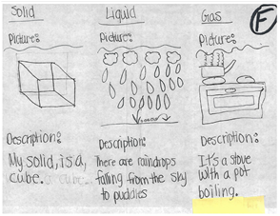
Fishbowl – student work

Slide 20
This place is SAFE but not necessarily COMFORTABLE.

Slide 21
Assessment Task Review Process
Intent Protocol
Learning targets
Success Criteria
Modifications

Slide 22


Slide 23
Assessment Task Review Process
Intent Protocol
Learning targets
Success Criteria
Student Work
Modifications

Slide 24
WestEd
Debrief

Slide 25
Wrap-Up
Summer Dates
Content Survey
Evaluation

Slide 26
Summer Support of the Science Networks
June 29-30 Elementary-Integrated learning experiences with science as the central context.
July 7-8 High School- Focus on intentional embedding of crosscutting concepts and practices into current units. Teachers will bring the units they are interested in revising.
July 21-22 Middle School- Progression and coherence of practices and cross-cutting concepts (based on phenomena) this will be tied to student growth goals. Also instructional and assessment ideas for 3D learning.

