Slide 1


Science Network
Meeting
October 23, 2014
Welcome!

Slide 2
Agenda
Introduction & Shifts in Instruction
Wave Experience
Assessment Literacy
Lesson Idea Development
Reflection & Wrap-Up
Notes:
Remind TLs of the note taking expectation that can be done on the paper agenda. Point out the posted list of Cross-Cutting concepts and state that as they reflect throughout the day to include which CCCs were touched upon

Slide 3
The Four Pillars of the Networks
Standards
Educational Leadership
Assessment Literacy
Characteristics of Highly Effective Teaching and Learning
Notes:
Through a capacity building approach, the goal of the Leadership Networks is to focus on professional learning around KCAS for Science, Characteristics of Highly Effective Teaching and Learning, Assessment Literacy, and Teacher Leadership in order to support College and Career Readiness for all students. You are one of the chosen few…one that can establish a precedence for other teachers in KY by advocating for change in the science classroom and in how student demonstrate mastery of their understanding at the state level.

Slide 4
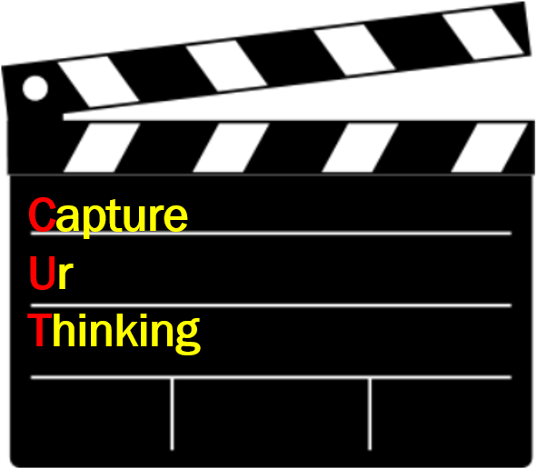
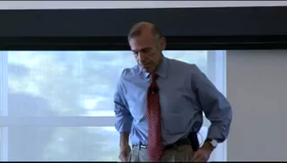
Making the Shift
http://vimeo.com/53913251
Notes:
Shifting to engaging students in minds-on. Thinking skills in science.

Slide 5
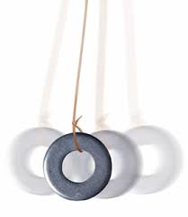

Consider Last Month’s Lesson…

Slide 6
Contrast with this experience…
Notes:
CUT question: Identify two striking differences in how the learning is experienced

Slide 7

Data Example
The following example was
taken from:
5 Practices for
Orchestrating
Productive Task-Based
Discussions in Science
2013, Cartier, Smith,
Stein, Ross
Notes:
CUT question: Identify two striking differences in how the learning is experienced

Slide 8
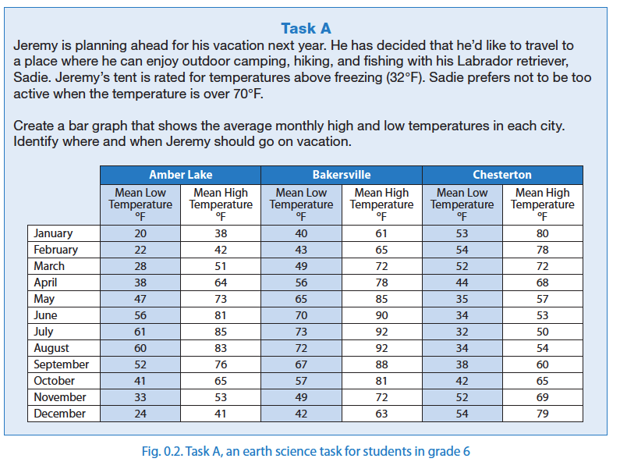
5 Practices for Orchestrating Productive Task-Based Discussions in Science
2013, Cartier, Smith, Stein, Ross

Slide 9
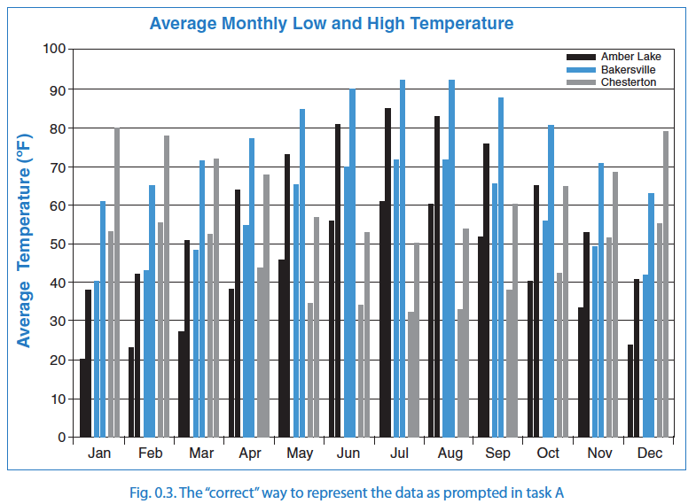
5 Practices for Orchestrating Productive Task-Based Discussions in Science
2013, Cartier, Smith, Stein, Ross

Slide 10
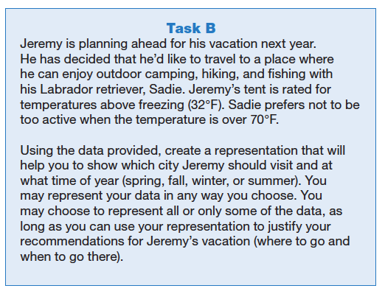
5 Practices for Orchestrating Productive Task-Based Discussions in Science
2013, Cartier, Smith, Stein, Ross

Slide 11
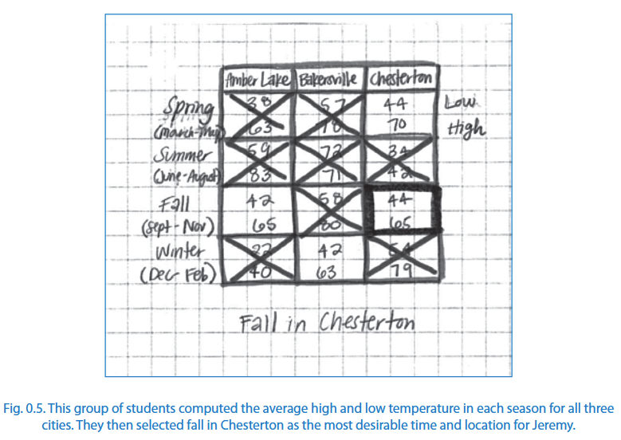
5 Practices for Orchestrating Productive Task-Based Discussions in Science
2013, Cartier, Smith, Stein, Ross
5 Practices for Orchestrating Productive Task-Based Discussions in Science
2013, Cartier, Smith, Stein, Ross

Slide 12
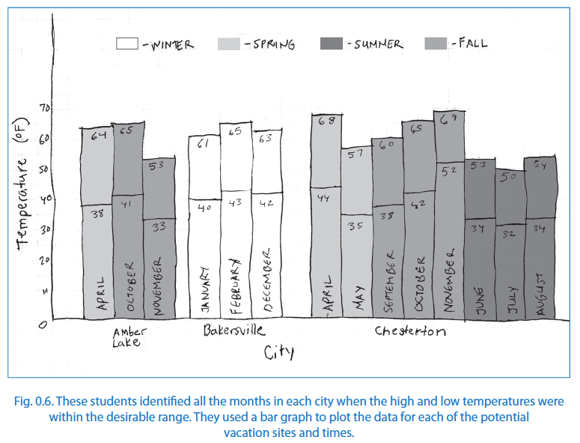
5 Practices for Orchestrating Productive Task-Based Discussions in Science
2013, Cartier, Smith, Stein, Ross
5 Practices for Orchestrating Productive Task-Based Discussions in Science
2013, Cartier, Smith, Stein, Ross

Slide 13
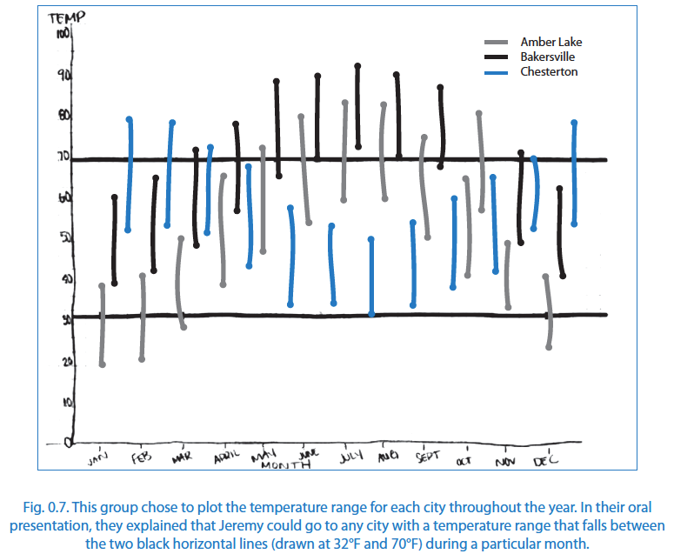
5 Practices for Orchestrating Productive Task-Based Discussions in Science
2013, Cartier, Smith, Stein, Ross
5 Practices for Orchestrating Productive Task-Based Discussions in Science
2013, Cartier, Smith, Stein, Ross

Slide 14
Data Example
Identify two striking differences in how the learning is experienced.

Slide 15
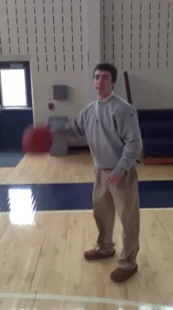
Waves – Pre-Assessment
Describe the wave-like characteristics you observed in the video.
What similarities and/or differences do you notice between wave motion and dribbling a basketball?
Record your thinking in in your notebook.

Slide 16
Science Performance Template
Gathering
Obtain Information
Reasoning
Evaluate Information
Communicating
Communicate Information
Ask Questions/Define Problems
Plan & Carry Out Investigations
Use Models to Gather Data
Use Mathematics & Computational Thinking
Analyze Data
Use Mathematics and Computational Thinking
Construct Explanations/Solve Problems
Developing Arguments from Evidence
Use Models to Predict & Develop Evidence
Using Arguments from Evidence (written/oral)
Use Models to Communicate
Notes:
Turn and talk…what do you recall about this template? How can it be used by teachers? Revisit thinking behind this tool and utility.
Hand out- GRC modified page .Have TL use the provided organizer to jot notes about the waves learning experiences

Slide 17
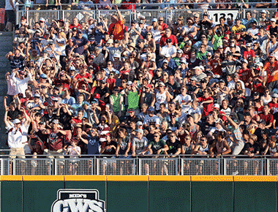
The Wave
October 15, 1981, is the day Krazy George Henderson invented the ''Mexican Wave”
''After the Wave, the crowd was noticeably different, hyped up and involved in the game. They knew they'd helped out. They felt the energy.”
Notes:
Lead TLs in the Live Wave model with folding two lines of chairs facing each other. Stop along the way to allow TLs to jot notes on their organizer. Focus only on the characteristics of amplitude, wavelength, frequency and energy transfer.
CUT questions posed along the way.

Slide 18

Transverse Slinky
center line
6”
6”
Recreate the transverse wave you generated as a human wave using a slinky instead. Explore the causes of changes in wave frequency, wavelength, and amplitude.
Position the slinky along the center line and use the 3” and 6” vertical marks to help make your observations semi-quantitative.
string resting point
6”
6”
3”
3”
baseline
Notes:
Packet is available to hand out at this time with directions and Tom’s article from SC.
Mindy, Nikkol, Amy and Christine will use formative assessment

Slide 19
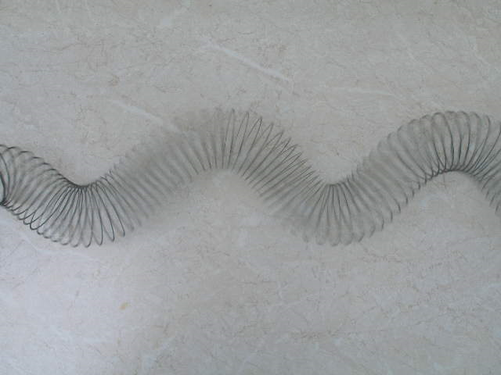
Transverse Slinky
Performance Task
Use the slinky to demonstrate the following wave characteristics:
  wavelength,
  amplitude,
  frequency,
  and energy
Demonstrate how wave patterns can change and how the wave’s energy is affected by changing amplitude and frequency.
Notes:
CUT question: As a teacher, think about what questions would be essential to have prepared to ask students as you circulate the room. What evidence are you seeking? What is the goal of this section of the lesson? How can you gather formative assessment information on an entire class while they engage in this experience?
Example: “Describe how this model is different from the human model.”
Explicitly point out use of the CCC … Why is the fact that wave motion is a PATTERN important? Leads way to mathematical representations necessary in upper grades and applications of waves in industry (engineering).

Slide 20
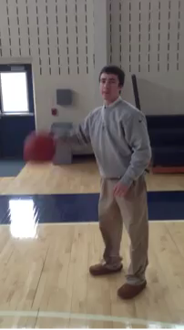
Wave-like Motion – Revisit
Identify all four characteristics explored in the two previous experiences using the paper provided.
  Amplitude
  Frequency
  Wavelength
  Energy transfer
Notes:
Do a Commit and Toss with the half-sheet explanation. Stepping through each of the four characteristics, ask for a volunteer that is pretty confident that what they have for the characteristic is correct and share out. Ask the room who has a similar answer … who has a different answer … make note of overall group understanding (whole class formative piece)
Lead discussion to develop common understanding and ways to address incomplete thinking and limitations of the model. (Wavelength – start and stop at same point.)

Slide 21
Break

Slide 22
Waves – Culminating Assessment
Create an analogy that demonstrates how wave-like occurrences can be represented as a wave. Identify and explain how each of the four wave characteristics is modeled in your analogy: amplitude, wavelength, frequency, and energy transfer.
Identify and explain any limitations of your analogy/model in representing these characteristics effectively.
Notes:
After individual work, have a table discussion and choose one to share. Be ready to state why it was chosen to share – what is special about it? Post on chart paper for the wall.

Slide 23
Gallery Walk
Share your analogy with your table.
As a table group, choose one analogy to share with entire group on a chart. Indicate why you choose this particular model.
Post on the wall.
Proceed on gallery walk/ use yellow half sheet to record your observations
Independently, observe at least 4 other models and record your thinking.
Notes:
CUT question is their reflection on the sheet provided.

Slide 24
Lunch

Slide 25
Assessment Literacy
4-PS4-1. Develop a model of waves to describe patterns in terms of amplitude and wavelength and that waves can cause objects to move.
7-PS4-1. Use mathematical representations to describe a simple model for waves that includes how the amplitude of a wave is related to the energy in a wave.
Notes:
If Gallery walk went long, debrief about the walk.

Slide 26
Assessment Literacy
Create an analogy that demonstrates how wave-like occurrences can be represented as a wave. Identify and explain how each of the four wave characteristics is modeled in your analogy: amplitude, wavelength, frequency, and energy transfer.
Identify and explain any limitations of your analogy/model in representing these characteristics effectively.
What evidence were we able to gather from the assessment?
Is it assessing 3D?
How can the prompt be revised to elicit the responses we want?
Notes:
So, tell us how we did on creating this assessment? What other questions would be nice to add? We would like to create a tool for evaluating tasks. Note: CCC was not address specifically, so it is only assessing 2 of the 3 dimensions
CUT question: What surprised you by looking at this item more closely? How has your question changed about this item now that you have looked at it more closely?

Slide 27
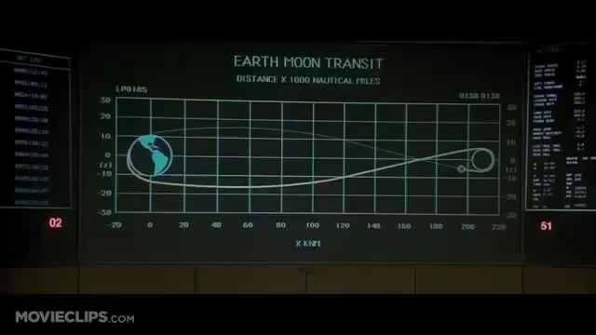
Determination
http://youtu.be/C2YZnTL596Q

Slide 28
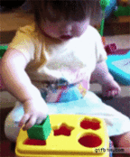
More than One Solution

Slide 29
Item Review/Development
What is the intent of the assessment items?
What is the item actually measuring?
Where does it connect or align to NGSS?
Does it address the appropriate depth for its grade-level?
Which of the 3 dimensions does the item incorporate?
How could it be revised to elicit the evidence of student learning we want to see?
Notes:
Move to grade groups. Give grade-level prompts from past released state ORQs and quarter sheet with questions.
If they would like to use the one they brought, they can choose to do so.
CUT question: What other questions would be helpful in reviewing items for effectiveness?

Slide 30
Break

Slide 31

Lesson Idea Development
Share the lesson idea you developed last time and an overview of the implementation in your classroom.
      Share up to 2 things you found positive about the lesson and one thing you would change.
Work on a new lesson idea with a partner and/or assessment task
Template- http://ovecsln.weebly.com
Notes:
2 stars and a wish for the sharing and suggestions piece.

Slide 32

Shift
In your notebook, capture something from today that highlights the need for a shift in science teaching and learning.
Share your thinking with your district team.
What can you immediately do in your Classroom that reflects this shift?
How can you help others in your School to understand and implement this shift?
How can you help others in your District to understand and implement this shift?
Notes:
C-S-D in notebook for recording of information.
Table talk

Slide 33
Wrap-Up
Evaluation
Homework: create and implement an assessment item/task in your classroom that addresses 3D learning. Ideally we would like to have student samples next month.
Next meeting: Nov 19th at the Oldham County Administrative Annex

