Slide 1


Science Network Meeting
November 19, 2014

Slide 2
Agenda
Shift Revisited
Task Evaluation
Question Formulation Technique
Hour of Code
Science Hub/MTOC
Mindset
FAL
Task Evaluation from Homework
Notes:
Not all of these need to be on there. Let me know what I can take off and what to reword

Slide 3
RIGHTS
You have the right to make contributions to an attentive and responsive audience and facilitator.
You have the right to ask questions.
You have the right to have your ideas discussed rather than your personality.
OBLIGATIONS
You are obligated to speak loudly enough for others to hear.
You are obligated to listen while others are speaking.
You are obligated to agree or disagree (and explain why) to other people’s ideas.
You are obligated to distill information, and make notes regarding how to translate to others.

Slide 4
Shifts happen…
What shift did you make last month and with whom did you make it?
Which of the five statements posted around the room bests summarizes the shift you made since the beginning of the school year? Travel to one area and find a person to be a listening partner.
1 minute shares – oldest shares first
3 minute small group share- find commonalities in shifts
5 minute whole group share of small group commonalities and/or the group’s biggest WOW!
Notes:
Make posters of statement- TL visit the one that best represents a shift they have made since our last meeting.
TL gather and then pair up for a 30 second partner share of the shift that has occurred.
Small cluster share to find commonalities
Whole group share our of commonalities
S- Students are taking ownership of their learning in my classroom
H- Heading up meetings to share STLN meeting information with colleagues
I- Including GRC strategy when planning my units.
F- Focusing on big explanatory ideas of the disciplines
T- Transferring learning through the lens of XCCs.

Slide 5
Shifts…
Conceptual shifts-
K–12 Science Education Should Reflect the Real World Interconnections in Science
Science and Engineering Practices and Crosscutting Concepts should not be taught in a vacuum; they should always be integrated with multiple core concepts throughout the year.
Science concepts build coherently across K-12
The NGSS Focus on Deeper Understanding and Application of Content
Integration of science and engineering
Coordination with Common Core State Standards

Slide 6

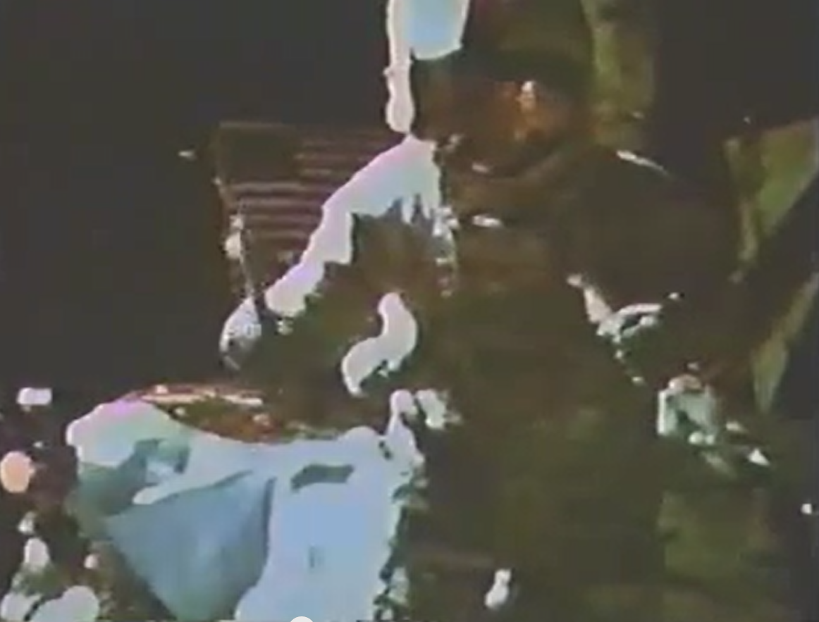
www.youtube.com/watch?v=5C5_dOEyAfk
Warm-up
Notes:
This video is to get folks thinking about forces, and be better prepared to answer questions about a baseball. Here are some suggested questions:
Would the hammer and feather drop the same on the Earth? Why?
No. There is no atmosphere on the Moon but there is an atmosphere on the Earth. Our atmosphere creates resistance (friction), which slows falling objects. On the Earth, both objects are affected by air resistance, but the feather is affected more than the hammer.
What force(s) are acting on the hammer & feather on the Moon? The force due to gravity is the only force. The Earth? The force due to gravity and the friction force (due to air resistance). Gravity due to the Moon is 1/6 the gravity due to the Earth. So if you weigh 150 pounds on the Earth you would weigh 25 pounds on the Mooon.
If a force is applied to an object, how does it affect the object? Forces cause objects to accelerate (change motion – speed up, slow down, or turn). It is possible to apply a force and an object not accelerate (force not high enough to overcome friction or structural forces, or the object deforms rather than change motion).

Slide 7
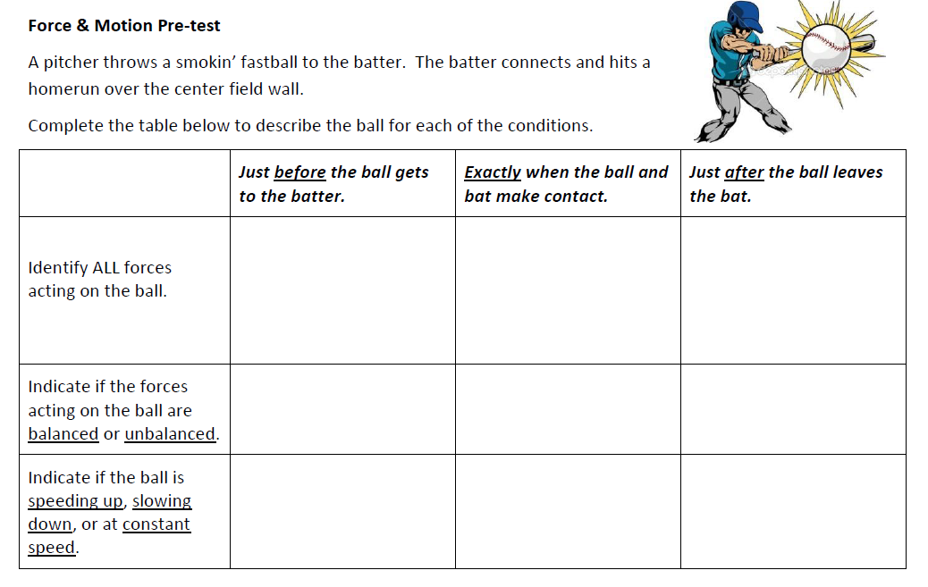
FAL Pre-test

Slide 8
Making the Shift

Slide 9
Shifts in Instruction – revisiting Waves
OLD – what are common past uses of a slinky for students to explore waves?

Slide 10
Shifts in Instruction – revisiting Waves
OLD – what are common past uses of a slinky for students to explore waves?
NEW – focusing on Practices (modeling) and Cross-Cutting Concepts (transfer energy)
1) During tabletop slinky investigations, what questions might you ask students about modeling?
2) What questions about energy?

Slide 11
Shifts in Instruction – revisiting Waves
3-D ASSESSMENT – assessing student ideas about scientific modeling
In this box, list ways in which the human model helped you think about waves. (models as tools for thinking)
In the “T” below, list pairs of statements highlighting differences (limitations) between human wave model and real-world slinky wave model
Human wave
different from
Real-world
slinky wave

Slide 12
Protocol Development & Item Analysis
Think - Pair - Double Share
Question: How do you determine if an assessment item measures the intent of the NGSS?
Think alone about the question for 3 minutes.
Pair up with a table partner to discuss your responses for 5 minutes.
Pairs share out at table and create a list of common responses to the question for 5 minutes.
Notes:
What were the questions we settled on for doing the Task Evaluation/Revision? Are we going to have them make a suggested revision for this one or just the next one? If this one is just the evaluation, I would say we stick with the first four bullets for this slide.

Slide 13
Break
Notes:
Click the alarm clock for online countdown timer of 15 minutes.

Slide 14
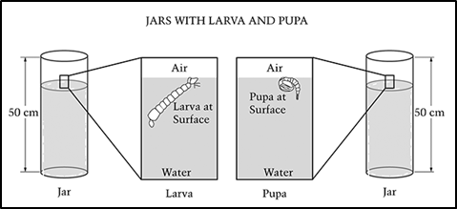
Protocol Essentials:
Double Share-
Each table group will share out one step of the process that they feel is necessary when evaluating an item for congruency with the NGSS.
If your table groups step has already been voiced, please provide a different step or suggest ways to improve those already recorded.
Using the provided item, let’s practice the newly developed protocol.
Notes:
Capture share out ideas on chart paper or on slide to be used in the afternoon…

Slide 15
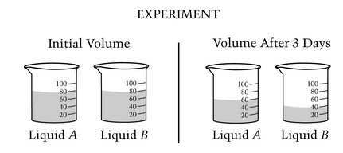
Task Evaluation/Revision
In grade-band groups of 4 or less people, use the developed protocol steps to evaluate the next task.
Select a recorder to gather capture the thinking process that occurs as the group works.
Consider whether or not the protocol is useful or if it needs to be modified to effectively support teachers when evaluating items .
Notes:
Are we going to have hand outs with all the questions on it and these two tasks? Christine is facilitating K-2, Nikkol 3-5, Mindy 6-8, and Tom 9-12.

Slide 16
Lunch and Learn
Notes:
Grab a lunch…
Last 15 minutes Mindy and I will share our info…

Slide 17

December 8-14, 2014
http://www.code.org
http://youtu.be/rH7AjDMz_dc

Slide 18
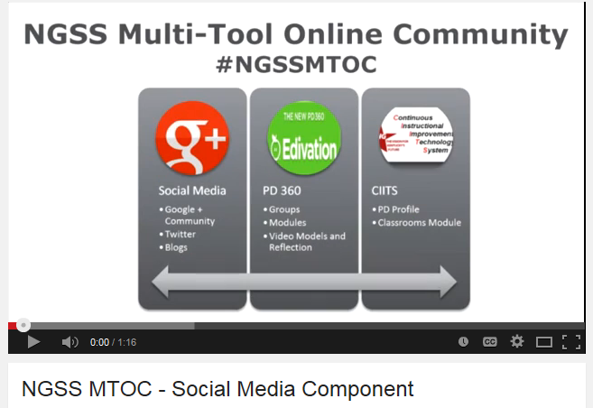
It is the long history of humankind (and animal kind, too) those who learned to collaborate and improvise most effectively have prevailed. -Charles Darwin
http://youtu.be/vek1RqLIJAE
Tutorial at http://youtu.be/KnkvIDZONNU?list=UUM5LDijiO3ool5PY3PEJFgw
Notes:
Welcome to the NGSS Multi-Tool Online Community (MTOC) a resource powered by teachers for teachers! Our vision is to establish a place where Kentucky educators learn, share and collaborate to implement the Next Generation Science Standards. True integration of the 3 dimensions of our new KCAS science standards requires significant shifts in instructional practices which can only be obtained through collaborative effort, collective conversations, and personal reflection. Through active participation in NGSS Tools community, educators will gain a better understanding of the standards and great Science teaching, find support and resources for implementation, and connect with others for professional growth. This community of educators will lead the way in facilitating positive change in science education by supporting others as they design classrooms of students as meaning makers, acting and thinking like scientists. The goal of this community is to foster personalized professional learning around the Next Generation Science Standards, engage in reflective practice, and create a shared collection of resources. This is a community formed by teachers for teachers, we need your voice, your expertise, and your participation to align our efforts and build something great to support student achievement in Kentucky.
We are really excited about the Social media component of the NGSS Multi-Tool Online Community. Implementation of the the Next Generation Science Standards provides an opportunity for KY teachers to transform science education in our state as well as throughout the country. Kentucky is leading the way in NGSS implementation creating an opportunity for KY teachers to align efforts, connect, learn , and share with other educators on a national scale. The Social Media Tool in our community is a global space for sharing resources, ideas, professional learning, blog reflections, and stories from the classroom. Social Media provides access to learning support from NGSS experts, peers, and scientists with rich and diverse backgrounds that can contribute to your on- going personalized professional growth. Social media is an active place where all teachers can lead from the classroom, coaching and supporting others while they learn themselves in both synchronous and asynchronous ways. We would like to bring people together across states to share our thinking and learning around the Next Generation Science Standards. Please bring your passion and expertise to our community. Every teacher has a great story to share and is an important part of this conversation.

Slide 19
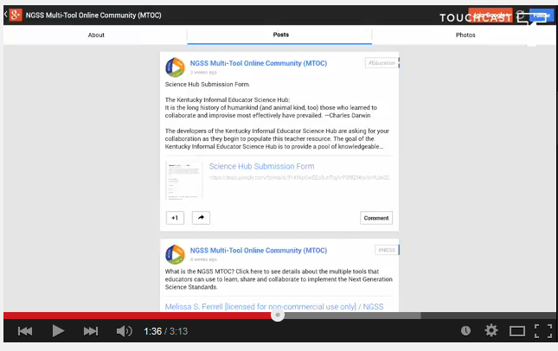
The Informal Educator Science Hub
http://tinyurl/ngssmtoc
Notes:
Within the NGSS Multi-tool Online Community is another resource that might be of interest to you. It is the IESH . The goal of the Kentucky Informal Educator Science Hub is to provide a pool of knowledgeable volunteers, from a wide range of backgrounds, that are willing to offer their time and expertise to work with and provide support to local K-12 science educators as they implement the new Kentucky Core Academic Science standards.
These persons can be from various backgrounds related to science. Reflect on those persons or organizations that have provide you with support throughout the school year. There are also numerous informal venues that offer valuable support to our students and to teachers. Please share those people and places that will be invaluable to your colleagues and our Kentucky students.

Slide 20

https://docs.google.com/forms/d/1uocntEv6GhVOogKNUCzXs7A_gD7GdXoLc7axVcIYCFc/viewform?c=0&w=1&usp=mail_form_link
Please help populate the Kentucky Science Hub
Notes:
The submission form can be accessed through the NGSS Multi-tool online community or at the link provided at the bottom of the slide. Please emphasize that all submission will be reviewed and that the person or organization being submitted will be notified as asked if they are willing to support educators in KY with the implementation of the science standards through this resource.
Please submit the person/organization that has supported you in science education. Once your submission is reviewed, a letter will be sent to the person/organization you have named in the form.
If you have any questions related to the Informal Educator Science Hub, please contact me at Christine.duke@education.ky.gov. Thank you in advance for helping to build this resource for all Kentucky teachers.
Share link to form.

Slide 21

Join professional list serves at http://www.coe.uky.edu/lists/kylists.php
Notes:
Just in case you aren’t receiving the Science Connection…go to link and join the K12Science list serve. The monthly Science Connection is distributed through this venue. This newsletter, as well as other content specific newsletters, can also be found on the KDE Newsstand at http://education.ky.gov/comm/Pages/KDE-Newsletters.aspx

Slide 22

Consider this…
The teacher is usually the person who asks the questions during a discussion. In a longitudinal study of elementary and secondary school classes, Dillon (1990) found that each student asks only one question(s) per month on average. Teachers must take deliberate steps to get their students to ask questions.

Slide 23



Question Formulation Technique™
QFT is ONE TECHNIQUE teachers may use to fulfill the STRATEGY “Engineering effective classroom discussions, questions and Learning tasks.”
Notes:
District Teams One Strategy…not the only strategy to help us with our professional learning today…also can be something that you apply in your own classroom

Slide 24
Key Components of QFT™
A Question Focus
The Rules for Producing Questions
Producing Questions
Categorizing Questions
Prioritizing Questions
Next Steps
Reflection

Slide 25
The Question Focus (QFocus)
A simple statement, a visual or aural aid to help students generate questions
Created from curriculum content
Designed to accomplish one or more of the following:
  Generate interest
  Stimulate new thinking
  Introduce a Topic
  Set a learning agenda
  Deepen comprehension
  Formative assessment
Should be brief and provoke or stimulate new lines of thinking.
Should not be a question.

Slide 26
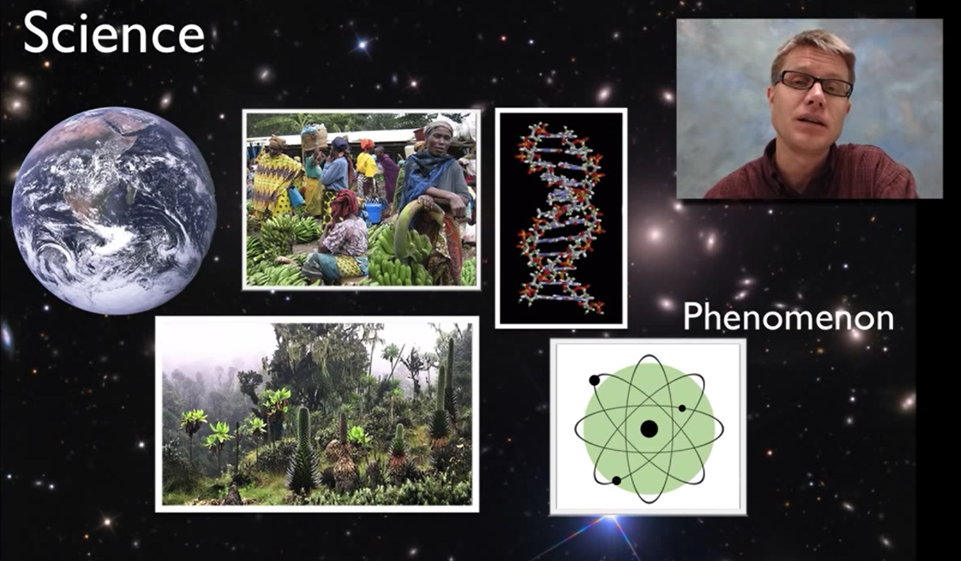
Science and Engineering Practice #1
http://youtu.be/LJJoKxDsyoQ

Slide 27
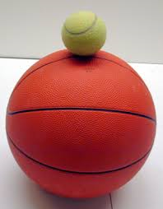
Experiencing the QFT Process
Notes:
Need to decide what Qfocus we want to give participants
Ask students to observe…be prepared to ask questions

Slide 28
Rules
1. Ask as many questions as you can.
Do not stop to answer, judge or discuss.
Write down every question exactly as it was stated. (Please number your questions.)
Change any statements into questions.
Notes:
Small groups of 3 – 5 students, produce as many questions as they can in allotted time.
Use one person as a note taker to write the questions and number the questions. (The note taker should also ask questions.)
Follow the Rules!
What do you think would be difficult about following these rules?
Which one of these rules might be difficult to follow? Why?

Slide 29
Categorizing Questions:
Closed/Open
Definitions:
  Closed-ended questions can be answered with a “yes” or “no” or with a one-word answer.
  Open-ended questions require
  more explanation.
Directions: Identify your questions as closed-ended or open-ended by marking them with a “C” or an “O”.
Notes:
Let’s shift to look at questions in a different way, specifically looking at closed and open-ended questions.
So with your partner, let’s relook at your questions and follow the directions on this slide…

Slide 30
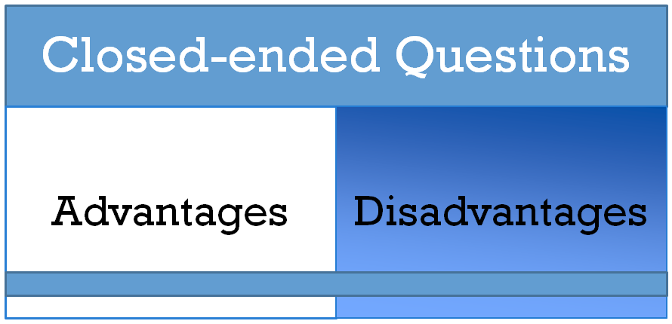
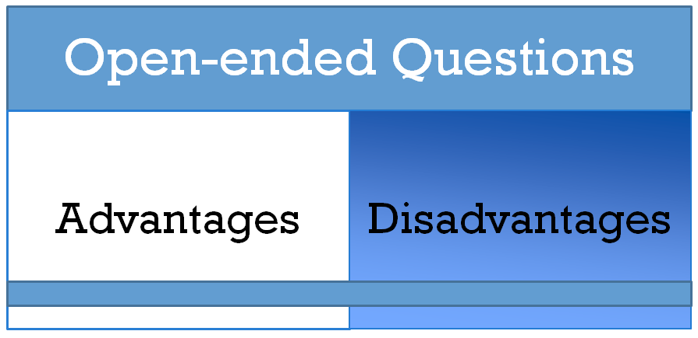
Discussion
Notes:
Discuss as a group, what could be potential advantages / disadvantages of closed and open ended questions.

Slide 31


Change Closed to Open
Directions: Take one closed-ended question and change it into an open-ended question

Slide 32
Thinking in many different directions
(Closed to Open Questioning)
DIVERGENT
THINKING

Slide 33
Narrowing Down, Focusing
(Open to Closed Questioning)
CONVERGENT
THINKING

Slide 34
Prioritizing Questions
Review your list of questions
Choose the three questions you consider most important.
While prioritizing, think about your Q-Focus:
Notes:
Think about the questions you shared and think about if there are ones that leap out at you as a particularly important question that you want to think about. So, take a minute with your partner and do some thinking around prioritization now. What was a question that you saw or you thought was important…
Let’s quickly share out some of those questions. *note, draw attention to those questions that begin to name the problem, or if any transition to what can be done to address the problem, or if anyone changed a closed to open question which may have allowed them to focus on specific steps they can take.

Slide 35
Prioritizing Questions
Why did you choose those three questions as the most important?
Where are your priority questions in the sequence of your entire list of questions?
Notes:
Note that the sequence of priority questions illustrates that as our understanding grows/ learning occurs, we refine our thinking, and we continue to ask questions.
Next steps may be defined by the teacher. Examples:
Conduct Research
Reports
Conduct Experiments
Independent Projects
Write Papers/Essays
Group and Individual Projects
Socratic Seminars/Debates
Prepare for Presentations/Interviews
Alternatively, students could decide how they will use their questions.

Slide 36

Reflection
What did you learn?
How did you learn it? What defensible evidence could you offer?
What do you understand differently now about asking questions?
Notes:
Okay… you just produced questions. You saw the process for changing questions and prioritizing questions. So, what did you learn? *Share*
So, then how did you learn what you learned? *Share*
What you see here is that when people did the learning, they figured things out; or when they began to problem solve, they did it by asking questions, by being engaged, by figuring things out themselves, but by using a structured and rigorous process for doing that which eliminates wasted time in finding the wrong question.
Subsequently, what do you understand differently now about asking questions? *Share*
Research from QFT suggests that when teachers use this process in the classroom, they feel that they are doing far more effective teaching and there is much deeper learning among the students.

Slide 37
QfT Next Steps
Next steps may be defined by the teacher. Examples:
  Conduct Research
  Reports
  Conduct Experiments
  Independent Projects
  Write Papers/Essays
  Group and Individual Projects
  Socratic Seminars/Debates
  Prepare for Presentations/Interviews
Alternatively, students could decide how they will use their questions.

Slide 38

Question Formulation Technique™
Register at The Right Question Institute for access to free resources.
http://rightquestion.org
Premise: students are more successful when they learn
to ask their own questions.
Allows students to practice three thinking abilities in one process: divergent, convergent and metacognitive thinking.

Slide 39

In My Classroom
Preparing to Use the QFT
Take a few minutes to begin thinking about how you can incorporate QFT into an upcoming unit of study...share your thinking with colleagues.

Slide 40
Reflection:
What aspects of the morning will you take back and share in your district?
Please use the agenda to capture your thinking !

Slide 41
SCIENCE Formative Assessment Lesson
Force & Motion
alpha version 11-2014

Slide 42
Intent of Lesson Approach
Modeled after MDC Formative Assessment Lesson Process – tools used to implement Common Core Standards for Mathematics
Typically be taught 2/3 of the way through a unit
Intent of these types of lessons is to engage students in a productive struggle that helps deepen conceptual understanding and allows students to correct flawed thinking based on their own reasoning.

Slide 43
The 5 Strategies of Assessment for Learning (the heart of MDC)
Clarifying and sharing learning intentions and criteria for success
Engineering effective discussions, questions and tasks that elicit evidence of learning
Providing feedback that moves learners forward
Activating students as the owners of their own learning
Activating students as instructional resources for one another
(Thompson & Wiliam, 2007)
Notes:
Dr. Shannon believes the #3 is the focus. If attention and growth take place in #3, the others will directly follow.

Slide 44
Today’s Experience for TLs
Facilitation of Learning
  Questioning
  Productive struggle
  Correcting misconceptions / incomplete thinking – the pre-assessment, card sort, and post assessment work together to allow the learner to construct reasoned understanding
Deepen Content Knowledge – even if you don’t teach at the level of this lesson, it’s important that all science teachers understand this content

Slide 45
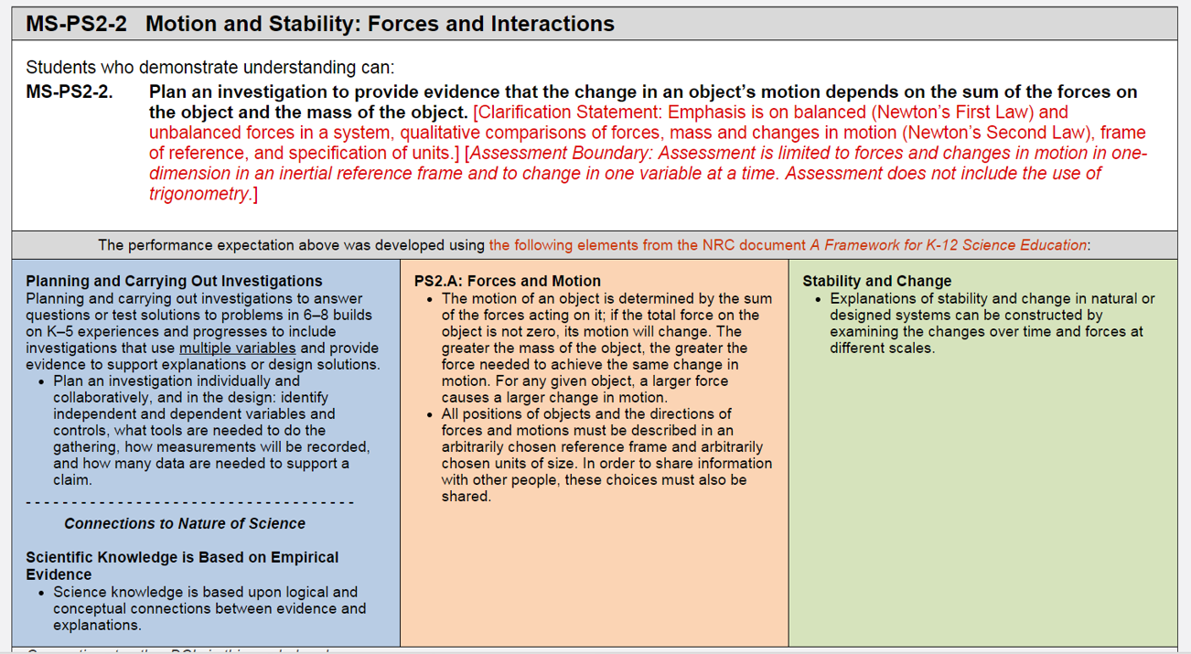
Notes:
This FAL would be especially appropriate at middle school based on congruency with NGSS, however, it could also be used at high school to reintroduce force & motion, for remediation, etc. It is designed to help people correct their misconceptions in the only way that it has been shown to truly be effective – make the meaning for themselves rather than have someone telling them. The whole class discussion and post assessment are a critical piece in this process.

Slide 46
Sort the cards into 2 categories:
1) forces acting on the box are balanced
2) forces acting on the box are unbalanced.
NOTE: A “push” indicates that hands are in contact with the box. A “shove” indicates that an abrupt force is applied by the hands but then the hands are not in contact with the box.

Slide 48
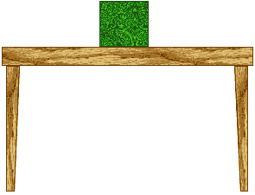
CORRESPONDING FORCE DIAGRAM
A BOX AT REST ON A TABLE
Fgravity
(Weight of box)
Fnormal
(Table pushing up on the box)

Slide 49
Pair each card with a force diagram.
1) Label each force on the diagram.
2) Indicate on each card: a) the forces are balanced / unbalanced b) the motion is speeding up, slowing down, or at constant speed.
NOTE: The grid is there to help you understand the relative magnitude of each force.

Slide 50
Sharing work
One person from each group get up and visit a different group.
If you are staying at your table, explain your card order to the visitor, justifying the placement of each card.
If you are the visitor, look carefully at the work and challenge any cards that you think are in the wrong place.
If you agree on the placement of the cards, compare your methods used when ordering.

Slide 51
Whole Class Discussion
Were there any disagreements when you shared your work?
Can someone give an example? What reasoning did you each give?
Does anyone agree with “student A?” Why?
Does anyone have anything to add?

Slide 52
Notes:
The next 6 slides are included to facilitate whole class discussion. May not be needed.

Slide 58
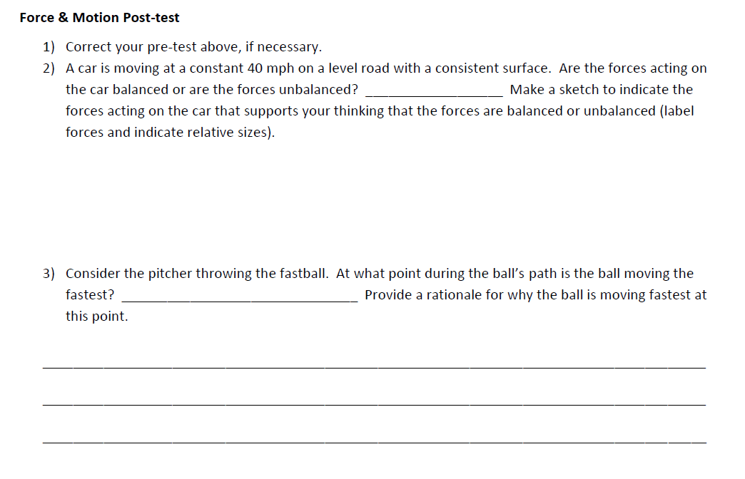
Post-test

Slide 59
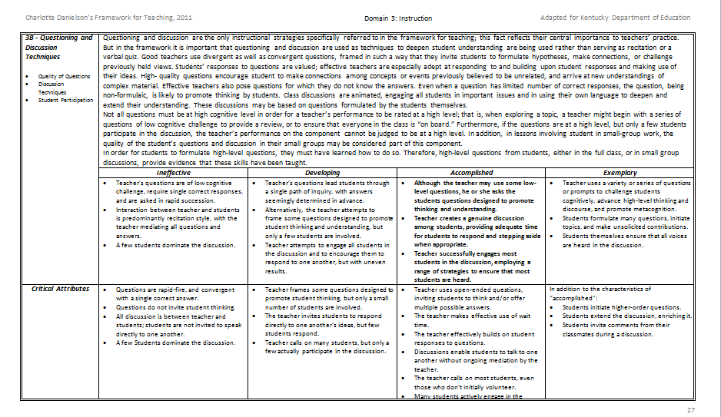
Domain 3: Instruction
3b – Questioning & Discussion Techniques
What might be
Defensible Evidence
of learning?
Notes:
Work together with your district teams to discuss…What might be some defensible evidence that teachers could elicit from students to demonstrate proficiency?

Slide 60
Questions? Feedback?

Slide 61
Break
Notes:
Click the alarm clock for online countdown timer of 15 minutes.

Slide 62
Task Evaluation/Revision
Using an assessment item you gave over the last 4 weeks and the protocol established this morning, revisit your assessment item or task for congruency with NGSS.
Revise and submit
Notes:
Were we going to try to get folks to send it in electronically beforehand? How are we facilitating this? Are they going to pair up, divide into small groups?

Slide 63
Final Thoughts
Reflect on the four pillars on your agenda. What will you share with your district from this afternoon?
Homework: Post assessment item to folder on webpage
Next meeting: January 22, 2014 at the OC Administrative Annex on Button Lane
Evaluation
Happy Holidays from the OVEC Facilitation Team

