Slide 1
OVEC Science Leadership Network
September 29th, 2015

Slide 2

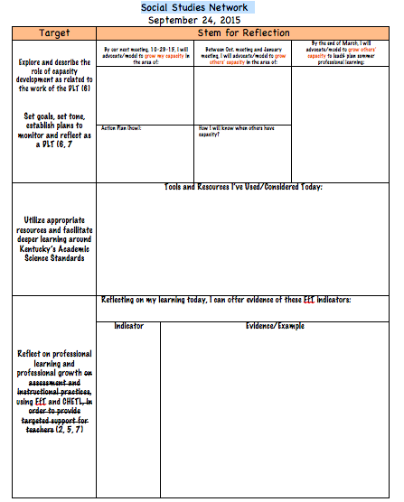
OVEC
September 29, 2015
All materials for today’s meeting can be found at http://ovecsln.weebly.com/

Slide 3

WELCOME BACK!
Candi Rumsey, KDE Science Instructional Specialist
Christine Duke, KDE Science Consultant
Mindy Curless, KDE Science/STEM Consultant
Dr. Tom Tretter, University of Louisville
Nikkol Bauer, Henry County
Tina Tipton, OVEC

Slide 4
AGENDA
Welcome/ Who Are WE?
Question Formatting Technique(QFT) – an excellent formative assessment technique
District Leadership Team (DLT )– Where are and where are we going?
Intent Protocol – to develop understanding of Performance Expectations(PE)
Evidence statement Analysis
SEP Templates – fishbowl
Connections to Framework for Teaching(FfT , CHELT, NGSS)
Closing, Evaluations

Slide 5
Who are we?

Slide 6
What We Teach?

Slide 8
Self Rating of your understanding and ease of implementing each of the three dimensions of the NGSS
Science & Engineering Practices (SEP)

Slide 9
Self Rating of your understanding and ease of implementing each of the three dimensions of the NGSS
Disciplinary Core Ideas (DCI)

Slide 10
Self Rating of your understanding and ease of implementing each of the three dimensions of the NGSS
Crosscutting Concepts(CCC)

Slide 11
THE SURVEY SAYS:
https://docs.google.com/forms/d/1OACCl-cSe_MVSxoy74eKtlM1YfdsrdDOCdr2NkASYQ4/viewanalytics

Slide 12

Be sure to introduce
yourself to new
folks at your table
Notes:
Kadi

Slide 13

What’s Your Advice?
The important thing about the network is….
While learning with others here at the network, be sure to….
I used to think, but now I know…
When challenged, think about….

Slide 14

NORMS
Pausing
Paraphrasing
Presume Positive Intentions
Posing Questions
Putting Ideas on the Table
Providing Data
Paying Attention to Self and Others

Slide 15
Network Vision
Every school district in the Commonwealth of Kentucky has a knowledgeable and cohesive leadership team that guides the professional learning and practice of all administrators, teachers, and staff so that every student experiences highly effective teaching, learning and assessment practices in every classroom, every day.

Slide 16

Question Focus????
#1. Science Teacher Leadership Network

Slide 17
Question Focus????
#2. Role of Teacher Leader

Slide 18
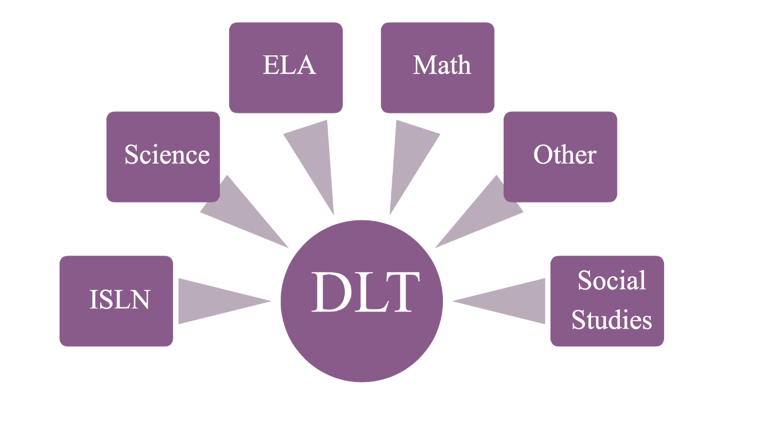
THE DLT & ME...
Teacher Leader
District Leadership Team (DLT)
Leading to Connect to Larger Community and World
Leading to Professionalize Teaching
Leading to Increase Teacher Voice and Influence
Leading Groups and Teams
Leading through Modeling and Coaching
Leading from the Classroom

Slide 19
Year at a Glance
Sept | Oct |  | Nov |  | Jan |  | Feb |  | Mar
Monthly Themes/Focus Questions
How can CAPACITY for GOING DEEPER be developed and sustained? | What IS Good Practice? How Do You Know? | How can PROFESSIONAL LEARNING support the growth of all educators? |  | What type of evidence supports the OPERATIONAL-IZATION of the FfT and CHETL? |  | How can the EXAMINATION OF STUDENT/ EDUCATOR WORK be supported as a routine for continuous improvement? |  | How can a DLT PLAN, SUPPORT AND SUSTAIN STRUCTURES AND ROUTINES that promote continuous growth and improvement?

Slide 20
Set goals, set tone, establish plans to monitor and reflect as a DLT (6, 7)
Science
Goals for the DLT
Explore and describe the role of capacity development as related to the work of the DLT (6)
Reflect on assessment and instructional practices, using FfT and CHETL, in order to provide targeted support for teachers (2, 5, 7)
Analyze & refine the existing structure/system in your district for educators to learn together and communicate learning. (7)
Utilize appropriate resources/protocols to facilitate deeper learning around specific content standards. (1)

Slide 21
Reflecting on DLT and the TL role
Practice using tools to audit Science lessons and interpret standards
Create a lesson where students Gather, Reason & Communicate
Building Capacity as a TL Supports a High Functioning DLT

Slide 22
Three, Two, One
After reading the articles write
3 things you discovered or thought about as you read
2 things you found interesting
1 question you have
Share with an elbow partner

Slide 23

“Build capacity of a DLT (that includes teacher, school, and district leaders) to have the skills, competencies, and resources to systemically plan for effective implementation of new standards by considering highly effective teaching practices, including deep understanding of the formative assessment process, and leveraging internal leadership to scale-up implementation district wide.”

Slide 24
DLT Table Discussion
Building Capacity at your school and District
What are your goals between now and the October meeting?
What are your goals for Fall/Spring/Summer/Next Year ?
Where am I and where am I going ??

Slide 26

Between now & November, we will….
Collaboratively interpret, create, implement & assess to Increase Student & Professional Learning

Slide 27
POSTER PAPER
As a TABLE not just your group:
Identify which questions from the QFT have not been answered.

Slide 28

When we reconvene, sit in grade band groups:
K-2
3-5
6-8
HS

Slide 29

Effective Professionals use tools and resources to improve, guide, and reflect on professional practice.

Slide 30
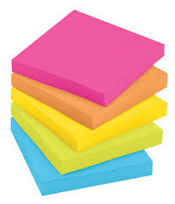

Intent Protocol for a
Performance Expectation
What is a PE you will be teaching this year?
Find a grade band partner that will also be teaching the same PE
Make sure you have orange, green and blue highlighters and sticky notes

Slide 31
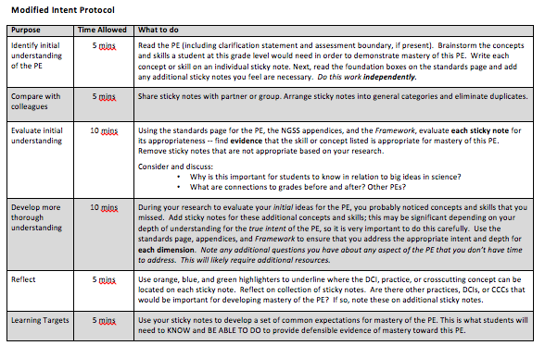

Slide 32
Speed Dating
What is the difference between the performance expectation (PE) and learning targets (LT)? What is their relationship?
What are the differences and similarities between the PE and the Evidence Statements (ES).
How are the LT different from ES?

Slide 33


Slide 34
Evidence Statements 101
What They Are
How They are Structured

Slide 35
Why Evidence Statements?
A PE and the accompanying foundation boxes have a lot of information (enough?), but they do not explicitly provide guidance about what it looks like for a student to use those three dimensions together in a purposeful way.

Slide 36
ES were written to help provide educators with:
what skills and knowledge students must be able to demonstrate for ‘proficient’ performance on any given PE at the end of instruction
what student performance at the nexus of the three dimensions looks like

Slide 37
ES for any given PE describe exactly the same expectations for students as the PE itself, simply with more detail…
An analogy: Imagine a leaf under a microscope: when the magnification increases, more features become visible. Those features were always present, but required a different level of scrutiny to make them apparent. Similarly, the content (across all three dimensions) included in the evidence statements is the same content included in the PEs, just at a different level of magnification.

Slide 38
Structure of the Evidence Statements
All Evidence Statements are written through the lens of the Science and Engineering Practice (SEP) associated with a given PE
The SEP is NOT most important, but it is the dimension that makes student work directly observable
NGSS writers created a TEMPLATE for each SEP at each grade band and then used those templates to generate Evidence Statements for each PE

Slide 39
Developing and Using Models
General observable features of the practices by the end of 2nd grade.

Slide 40
Developing and Using Models
General observable features of the practices by the end of 2nd grade.

Slide 43
Developing and Using Models
General observable features of the practices by the end of 2nd grade.

Slide 44
Planning and Carrying Out Investigations
General observable features of the practices by the end of 5th grade.

Slide 47
Planning and Carrying Out Investigations
General observable features of the practices by the end of 5th grade.

Slide 48
common misunderstandings
The evidence statements describe what students should do in a lesson in the classroom.
The evidence statements describe teacher practice, rather than student performance.
The evidence statements describe student tasks, both in an instructional and assessment context.
The evidence statements are specifically intended to inform formative assessment.
The evidence statements add content or go beyond what is asked by the PE.
The practice structure implies metacognitive demands, rather than practice-based expectations.
Because the evidence statements are in a list/outline form, individual bullets can be taken out of context and used for instruction and assessment purposes
The word ‘describe’ implies oral or written, detailed, grammatically correct responses.

Slide 49
Recap…
The structure of the ES is through the lens of the SEP because that’s what is directly observable about student work
Templates were created for each SEP to provide a framework and ensure consistency
ES describe the skills and knowledge students must be able to demonstrate for ‘proficient’ performance on any given PE at the end of instruction
ES describe what student performance looks like at the nexus of the three dimensions
ES for any given PE describe exactly the same expectations for students as the PE itself, simply with more detail

Slide 50
The next slides are for the ES Template Fishbowl & TL Practice using the Templates

Slide 51
Planning and Carrying Out Investigations
General observable features of the practices by the end of 5th grade.

Slide 52
Process to use ES templates in lesson design
identify learning outcomes for a lesson
use the evidence statement templates to see how demonstrating evidence for that learning outcome is reflected through a practice. Consider all practices.
modify your learning outcomes based on what you've learned
modify your lesson to ensure that the students will be using the practices as intended.

Slide 53
Original learning outcomes
Measure off a square meter
Devise a way to collect the data
Collect the data accurately
Organize the data in a way that helps them interpret and analyze it

Slide 54
Modified Learning Outcomes based on ES Templates
1. Students collaboratively develop a plan that includes:
  how the site will be measured and marked off
  how they will count the organisms accurately (considering factors that might affect outcome – duration, time of day, conditions, etc.)
  what data/information they will record
  how they will record the data (materials used, structure for recording)
2.Students collaboratively execute the plan
  Measure and mark off the 1 square meter area
  Collect and record the data systematically
3. Organize the data in a way that communicates the biodiversity in the area evaluated

Slide 56
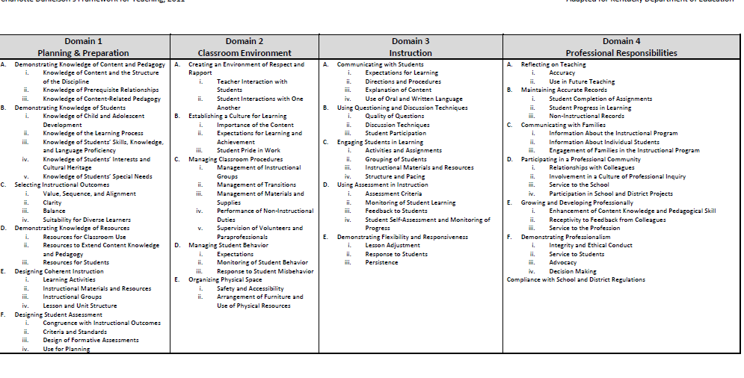

Slide 57
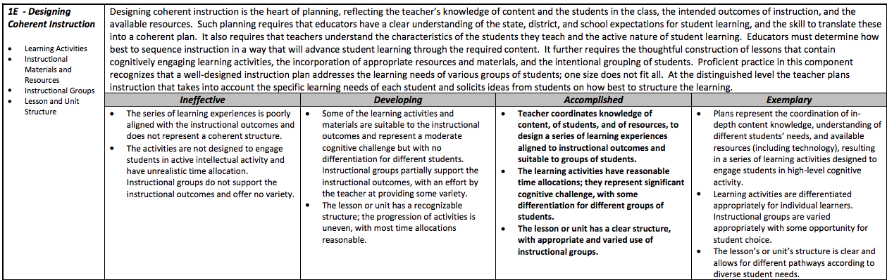
On which components of the FfT have you generated evidence today?

Slide 59

KSTA Conference
Nov. 5th – 7th in Lexington

Slide 60

Turn in your evaluation
& nametag
Before the next meeting:

