Slide 1


Science Network
Meeting
November 22, 2013
Welcome!
Please make sure you pick up one copy of each handout from the table before we begin
Notes:
Science—and therefore science education—is central to the lives of all Americans, preparing them to be informed citizens in a democracy and knowledgeable consumers. It is also the case that if the nation is to compete and lead in the global economy and if American students are to be able to pursue expanding employment opportunities in science-related fields, all students must all have a solid K–12 science education that prepares them for college and careers

Slide 2
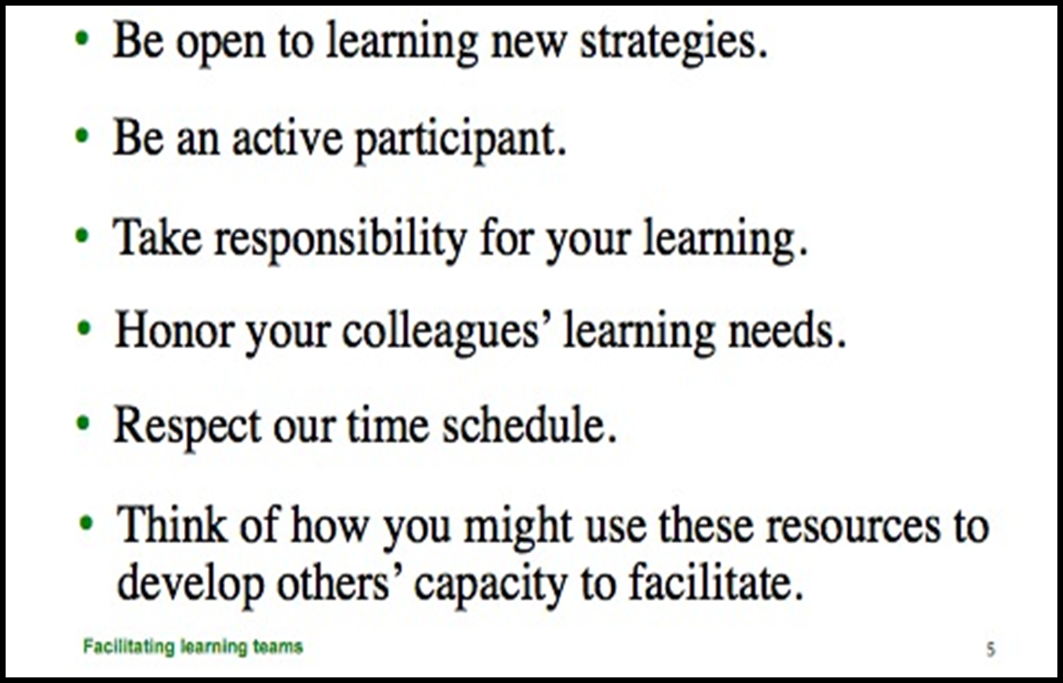
Team Norms- Learning Forward

Slide 3
Goals for the day
Articulate the importance of a balanced assessment system in planning, implementing and assessing the new science standards.
Describe the purpose and value of learning targets for designing assessments and planning instruction.
Become familiar with KY’s process for deconstructing standards into learning targets.
Engage in the engineering design process to solve a defined problem.
Identify and strengthen appropriate connections of the Science and Engineering Practices in current instruction.
Be prepared to assist others in strengthening connections to the Practices in their instructional planning.
Establish personal/school/district leadership goals, with appropriate measures of success.

Slide 4
Network Vision
“Every school district in the Commonwealth of Kentucky has a knowledgeable and cohesive leadership team that guides the professional learning and practice of all administrators, teachers, and staff so that every student experiences highly effective teaching, learning, and assessment practices in every classroom, every day.”

Slide 5

Building Capacity Around the 4 Pillars

Slide 6
The Four Pillars of the content networks
Standards
Educational Leadership
Assessment Literacy
Characteristics of Highly Effective Teaching and Learning (CHETL)

Slide 7
Continuous formative assessment & virtual parking lot
http://padlet.com/wall/OVECSLN1122

Slide 8
Follow up from October evaluations
More time to work with colleagues
Focus more on science and less on the other pillars
Creating lessons and activities
List of learning targets
How do I communicate this in my district?
Why are there so few primary teachers here?
Don’t see the value of discussing FFT and CHETL

Slide 9
Cell (talking) Partners
Establish talking partners for future collaboration
Be sure you write down each other’s names in the same spots

Slide 10
Innovation Configuration Maps
“Who said that?”
Anonymous data collection for formative assessment
Summarize your conversation regarding the Innovation Configuration Maps

Slide 11


Discussion
Questions

Slide 12
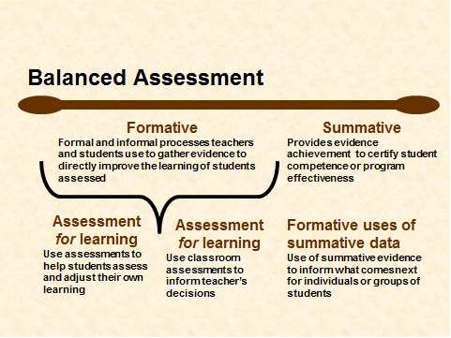
Notes:
Begin with a Review of Balanced Assessment Literacy
Address Learning Target: Articulate the importance of a balanced assessment system in planning, implementing and assessing the new science standards.

Slide 13
Key Characteristics of Assessment Literacy
Key 1
Clear Purpose
Key 2
Clear Targets
Key 3
Sound Design
Key 4
Effective Communication
Key 5
Student Involvement
Notes:
The first discussion round refers to the 5 Key Characteristics of Assessment Literacy. (Text page 5). All of the pieces contributing to sound classroom assessment instruments and practices are built on a foundation of the following five keys to quality. Key 1 They have a clear purpose…they are designed to serve the specific information needs of intended uses. Key 2 they are based on clearly articulated and appropriate achievement targets, Key 3…accurately measure student achievement, Key 4…yield results that are effectively communicated to users, and Key 5 involves the student in self-assessment, goal setting, tracking, reflecting on and sharing their learning)

Slide 14
CASL Chapter 1
Classroom Assessment Every Student a Learner
Locate your Nucleus Partner.
Think of a time you yourself were assessed and it was a negative experience. What made it negative?
Which of the five keys to assessment quality were involved in your negative experience?
Think of a time you yourself were assessed and it was a positive experience. What made it positive?
Which of the five keys to assessment quality were involved in your positive experience?
What impact did each experience have on you?
Notes:
TPT Bounce -

Slide 15
CASL Chapter 2 - Clear Purpose
Seven Strategies of Assessment for Learning (pg. 28)
Where am I going?
1. Provide a clear and understandable vision of the learning target.
2. Use examples and models of strong and weak work.
Where am I now?
3. Offer regular descriptive feedback.
4. Teach students to self assess and set goals.
How can I close the gap?
5. Design lessons to focus on one learning target or aspect of quality at a time.
6. Teach students focused revision.
7. Engage students in self reflection, and let them keep track of and share their learning.

Slide 16
Clear Purpose:
Assessment for and of Learning
A. Locate your _______?___partner to share which of the Seven Strategies of Assessment for Learning, which do you feel that you implement most effectively Least effectively
B. After discussing why one strategy is easier to implement effectively than an other, travel to the ladder chart to record your responses.
Green- most effectively implemented
Red- least effectively implemented
Notes:
With your ____________ partner, discuss which of the seven strategies of assessment for learning that you feel you implement most effectively? Least effectively?

Slide 17

Learning/Achievement Targets
Statements of what we want students to learn and be able to do.

Slide 18
A Mathematics Example
Subject
Math
Decimals
Page 152 in the book
Going on a decimal hunt
Read decimals and put them in order
Topic
Assignment
Activity
Learning Target

Slide 19
Why learning targets?
If TEACHERS don’t explicitly know what the standards require students to learn, how can they intentionally plan for them to learn it?
If TEACHERS don’t explicitly know what the standards require students to learn, how can they design assessments to tell them if their students are learning it?
If STUDENTS don’t know what they are supposed to learn, how can they tell they are making progress toward learning it?

Slide 20
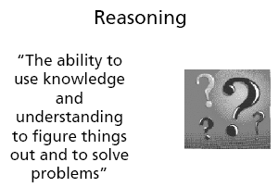
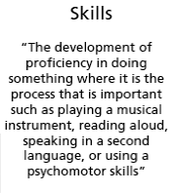
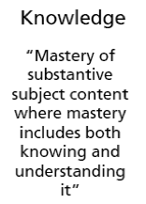
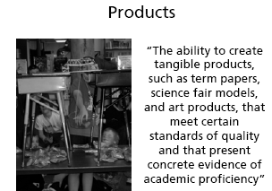
Classifying Targets

Slide 21
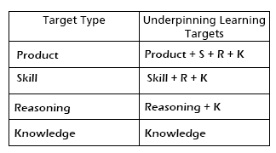
Once you’ve identified the overall type of STANDARD, you’ll have a better understanding of the likely TARGET TYPES

Slide 22

Creating Targets for “Driving a Car with Skill”
What knowledge will students need to demonstrate the intended learning?
What patterns of reasoning will they need to master?
What skills are required, if any?
What product development capabilities must they acquire, if any?

Slide 23
Driving a Car with Skill
Knowledge
  Know the law
  Read signs and understand what they mean
Reasoning
  Evaluate ‘am I safe’ and synthesize information to take action if needed
Skills
  Steering, shifting, parallel parking, …
Products
  (not appropriate target for standard)

Slide 24
“Without the learning intention, children are merely victims of the teacher’s whim.”
“The sharing of learning intentions is, however, more complex than simply repeating what is in the teacher’s plan.”
Shirley Clarke in Unlocking Formative Assessment

Slide 25

Clear Statement of Learning Target
Skill or concept to be defined: PREDICTION
Planning target
Recognize a prediction as a statement saying something will happen in the future.
Student-friendly language for target:
I can make predictions. This means I can use information/evidence to describe what is likely to happen next.

Slide 26
Students who can identify what they are learning significantly outscore those who cannot.
  Robert Marzano

Slide 27
Student Friendly Language
From K-3 Deconstruction
“Observe and describe properties of material objects”
Student Friendly Language:
I can describe the physical properties of objects that I can see, touch, and/or smell.

Slide 28
Student Friendly Terms
We are learning to…
We’ll know we’ve achieved this because…

Slide 29

“Any student who leaves school still needing their teacher to tell them that they’ve done well has not yet learned to hit the target. They’ve not yet learned to recognize good thinking.”
  Rick Stiggins

Slide 30
From Standard to Target
Begin by answering three questions:
What are the key words/concepts?
What do students need to know and do?
What is the intent of the performance expectation/learning?

Slide 31
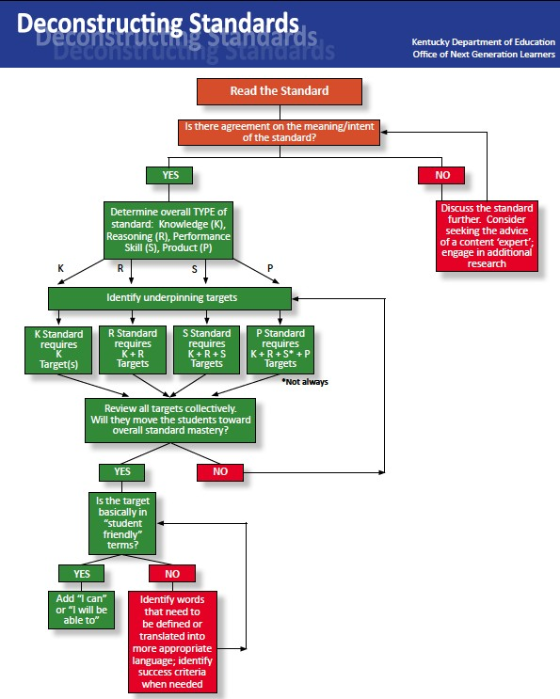

Slide 33
What are the key words/concepts?
What do students need to know and do?
What is the intent of performance expectation/learning?
Analyze data to determine if a design solution works as intended to change the speed or direction of an object with a push or a pull.* [Clarification Statement: Examples of problems requiring a solution could include having a marble or other object move a certain distance, follow a particular path, and knock down other objects. Examples of solutions could include tools such as a ramp to increase the speed of the object and a structure that would cause an object such as a marble or ball to turn.] [Assessment Boundary: Assessment does not include friction as a mechanism for change in speed.]

Slide 34
What are the key words/concepts?
What do students need to know and do?
What is the intent of performance expectation/learning?
Analyze data to determine if a design solution works as intended to change the speed or direction of an object with a push or a pull.* [Clarification Statement: Examples of problems requiring a solution could include having a marble or other object move a certain distance, follow a particular path, and knock down other objects. Examples of solutions could include tools such as a ramp to increase the speed of the object and a structure that would cause an object such as a marble or ball to turn.] [Assessment Boundary: Assessment does not include friction as a mechanism for change in speed.]

Slide 35
What are the key words/concepts?
What do students need to know and do?
What is the intent of performance expectation/learning?
Analyze data to determine if a design solution works as intended to change the speed or direction of an object with a push or a pull.* [Clarification Statement: Examples of problems requiring a solution could include having a marble or other object move a certain distance, follow a particular path, and knock down other objects. Examples of solutions could include tools such as a ramp to increase the speed of the object and a structure that would cause an object such as a marble or ball to turn.] [Assessment Boundary: Assessment does not include friction as a mechanism for change in speed.]

Slide 36
Knowledge Targets
Describe pushes/pulls as forces that move an object.
Know that speed is how fast something moves.
Identify change as a difference in something.
Recognize that “data” is collected information.

Slide 37
Reasoning or Performance Skill Targets
Describe the relationship between the strength of the push or pull and the change in speed or direction.
Infer that people can cause change in an object’s speed or direction.
Interpret speed/direction data to support a claim that the design solution worked or not.

Slide 38
Product Targets
No products

Slide 39
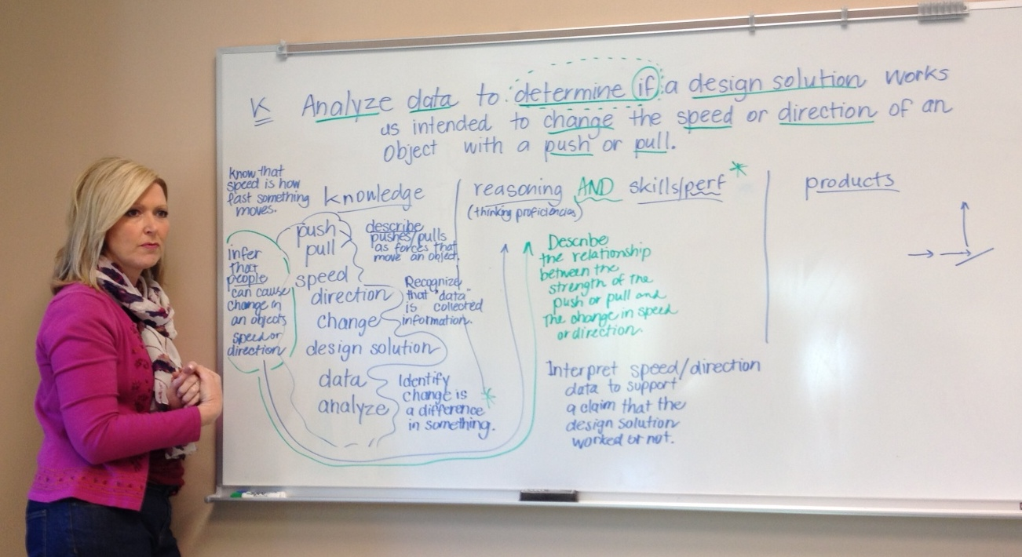

Slide 40
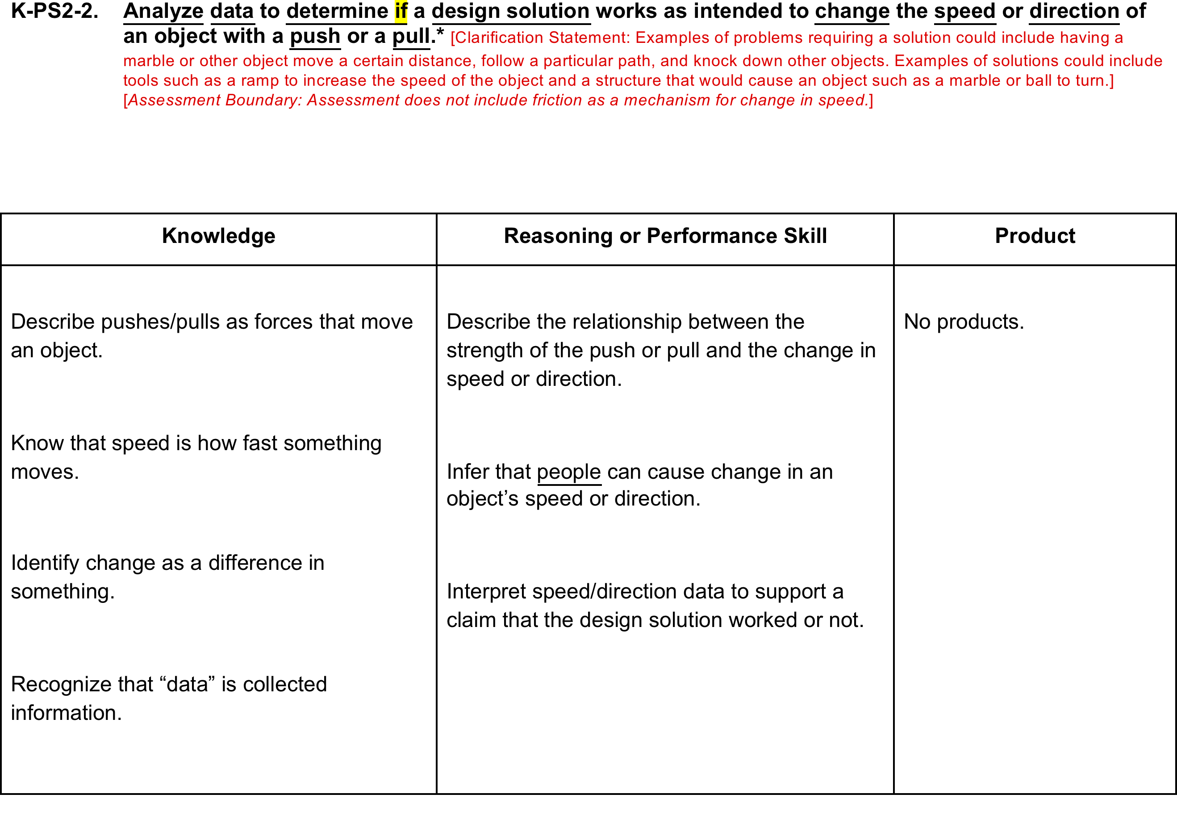

Slide 41
Let’s do 3-PS2-1 together
What are the key words/concepts?
What do students need to know and do?
What is the intent of the performance expectation/learning?
Knowledge Targets | Reasoning and/or Performance Skills Targets | Product Targets

Slide 42
The ultimate evaluation criteria for learning targets:
“If my students can successfully meet all of these individual targets, will they have met the full intent of the standard?”

Slide 43
You practice
Choose a PE for the grade/subject you teach, preferably one incorporating the CCC of cause & effect.
Deconstruct the standard into learning targets using the process we practiced today
Share (details to follow)

Slide 44

Marshmallow Design Challenge
Target: Engage in the engineering design process to solve a defined problem
The Challenge: Using only the materials given, build the tallest freestanding structure that will support a marshmallow.
RULES:
  Build the tallest freestanding structure
  The entire marshmallow must be on top
  Use as much or as little of the kit, except the envelope
  Okay to break up the spaghetti, string or tape
  The challenge lasts 15 minutes
Ready, set, GO
Notes:
Each group gets 20 sticks of spaghetti, 3 feet of string, 3 feet of tape, and one marshmallow. Provide scissors and tape measures.
Explain the challenge and go over the rules. Start the timer. When groups hear the buzzer, hands up (like on Chopped).
Wrap up activity by determining the highest tower and provide accolades to the winning group. Ask a few folks to speculate why that tower was the tallest.

Slide 45
Dare to Disagree
http://www.ted.com/talks/margaret_heffernan_dare_to_disagree.html

Slide 46
Just Fluff?
Using the Appendix I matrix, evaluate the Marshmallow Design Challenge
Does this challenge, as presented, meet the Engineering Design Performance Expectations in your grade band?
Could it be modified to better address the PEs?
Notes:
Make sure participants have the Appendix I synthesis by M. Curless, point out that this is a summary of the ETS standards in each grade band. Participants are welcome to use the actual Performance Expectations as well.
Engage in whole group discussion about the engineering activity

Slide 47
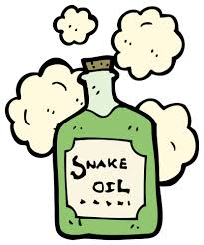
Be a Skeptic
Google search for “middle school engineering challenges” yields 17,800,000 results
Just because an activity advertises engineering, does not mean that it fulfills the intent of the standards.
A key task for you as science leaders for your district is to be a productive skeptic, and to encourage others to be as well

Slide 48
Strengthening the Practices in Current Instruction
TARGET: Identify and strengthen appropriate connections of the Science and Engineering Practices in current instruction. Be prepared to assist others in strengthening connections to the Practices in their instructional planning.
Focus: Intentionality of incorporating practices

Slide 49
Strengthening the Practices in Current Instruction
PROCESS:
Join your content-alike team (same grade bands) – form 4-person groups
Bring your current unit, and a description of Practices
Using the current unit each brought, engage in a 15-min cycle per person:
A person presents their unit to the team (include context as needed)-5 min.
Rest of team offers suggestions & ideas for strengthening Practices (focus on strengthening the intentionality of addressing practices in instruction)
One person is the designated skeptic (asking for evidence, etc.)
Rotate after 15 minutes to next person and their unit. Skeptic role rotates.

Slide 50
Strengthening the Practices in Current Instruction
CLOSURE:
How are practices stronger as a result of this activity?
What value was contributed by having a skeptic as part of the process?
What were challenges of being the skeptic?
How might this type of activity be used within your district?

Slide 51
Meeting dates
January 30
February 27
March 27

Slide 52
Taking it back
(sharing the love)
District team
Develop specific, realistic goal(s) for sharing what you have learned with your school and/or district
Between today and January 30
What, when, measure of success

Slide 53
Follow up
Read Chapters 4-6 in the Classroom Assessment for Student Learning (CASL) book
Deconstruct a standard of your choosing (focusing on cause and effect) and share
Implement the revised unit you shared today
Bring an assessment you created to next meeting
Be on the lookout for a scheduling email
Go be a leader!

