Slide 1
Science Network
Meeting
September 23, 2013
Welcome!
Please make sure you pick up one copy of each handout from the table before we begin
Notes:
Science—and therefore science education—is central to the lives of all Americans, preparing them to be informed citizens in a democracy and knowledgeable consumers. It is also the case that if the nation is to compete and lead in the global economy and if American students are to be able to pursue expanding employment opportunities in science-related fields, all students must all have a solid K–12 science education that prepares them for college and careers

Slide 2
Who is on the OVEC Science Network Team?

Slide 9
Notes:
Carroll County

Slide 10
Notes:
Owen County

Slide 14
Notes:
Eminence

Slide 19
Team Norms- Learning Forward

Slide 20
Goals for the day
Understand the structure and purpose of the science leadership network
Develop understanding of your role as a science teacher leader in your district
Gain familiarity with the origin, structure and instructional implications of the new KCAS science standards
Begin initial discussions of implementation plans foryour districts

Slide 21
Why Are We Here ?
2009’s Senate Bill 1 requires:
that the Kentucky Department of Education (KDE) in collaboration with the Council on Postsecondary Education (CPE) plan and implement a comprehensive process for revising the academic content standards in all areas

Slide 22
2009’s Senate Bill 1 requires:
Revision of content standards in all subjects that:
Focus on critical knowledge and skill;
Result in fewer, but more in-depth standards to facilitate mastery learning;
Communicate expectations more clearly and concisely; Be based on evidence-based research;
Consider international benchmarks; and
Ensure that the standards are aligned from elementary to postsecondary so that students can be successful at each education level

Slide 23
Consideration of national standards where available
Senate Bill 1 also mandates professional development programs be made available to teachers that include:
Assessment literacy
Research-based instructional practices
Educational leadership

Slide 24
Building Capacity Around the 4 Pillars

Slide 25
The Four Pillars of the content networks
Standards
Educational Leadership
Assessment Literacy
Characteristics of Highly Effective Teaching and Learning (CHETL)

Slide 26
Continuous formative assessment & virtual parking lot
http://padlet.com/wall/913ovecsln

Slide 27
Commit and toss
New Standards?
Knows there are new standards, little specific knowledge of structure and implications
Has some familiarity with the structure
Knows structure, origin and has started to consider instructional implications
Could lead a training on the Science KCAS

Slide 28
Qualities Of A Leader
http://www.youtube.com/watch?v=Z7O8s6NgAck

Slide 29
What are some ways that you show leadership within your school or district?
How do you view your role as a member of this Science Network?
Notes:
Walk around and capture key phrases from conversations. Share them out with the whole group.

Slide 30
The “Right” Network Participants
Task:
Take five minutes to review Characteristics of the “Right” Network Participants
Reflect Individually:
What qualities to I bring to the work?
How do my individual strengths support this vision?
Notes:
Direct attention to Characteristics of the “Right” Network Participants

Slide 31
The Focus of Leadership Networks
The focus of the networks is capacity building, not a “train the trainer” model.
View the T-Chart, as a table discuss the main differences that you notice.
Notes:
Direct attention to Leadership Networks: Capacity Building vs ‘Train the Trainer’ Handout.

Slide 32
Building Capacity
Develop Skills
Increase Knowledge
Use Resources to Develop a Plan to Meet Specific District Needs
Customized
Long Term Sustainable Model
Notes:
Review the Focus of Building Capacity.

Slide 33
District Leadership Resume
The strength of the team is each individual member. The strength of each member is the team.
-Coach Phil Jackson
Work together as a District Team to Showcase Your Experiences, Achievements, Strengths, and Qualities.
Notes:
Now that you have had time to process the goals of our Leadership Network, we would like for you to collaborate together as a District Leadership Team to construct a resume. This resume should showcase your experiences, achievements, strengths and qualities.
Record your resume in a format of your choice on the chart paper provided. As you complete your resume, we will display them around the room for people to view through out the day. Some of our greatest assets are our ability to network. This will give you a clear picture of who is in the room and potential contacts for support.

Slide 35
A Framework for K-12 Science Education
Philosophical Underpinnings and Overview

Slide 36
What it is
Articulates scope and nature of science education
Purpose is to guide the development of standards
Primary elements of the framework:
Major science & engineering practices
Cross-cutting concepts
Disciplinary core ideas

Slide 37
Why we need it
New understandings in science since 1996 National Science Education Standards
44 million cell phone users in US (now over 300 million)
Motorola StarTAC = first flip phone (most popular cell phone in 1996)
NOTE: it only made phone calls

Slide 38
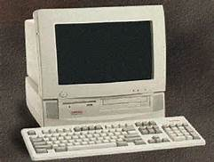
Why we need it
New understandings in science since 1996 National Science Education Standards
44 million cell phone users in US (now over 300 million)
43 million (44%) of US households own a personal computer, and 14 million of them (14%) are online
Motorola StarTAC = first flip phone (most popular cell phone in 1996)
NOTE: it only made phone calls
In 2010:
71% of US households are online (over 90% of these have broadband connection)

Slide 39
Why we need it
New understandings in science since 1996
The Intergovernmental Panel on Climate Change (IPCC) was established in 1988. Consensus report from 1200 authors and 2500 expert reviewers from 130 countries
1995 IPCC report "our ability to quantify the human influence on global climate is currently limited because the expected signal is still emerging from the noise of natural variability, and because there are uncertainties in key factors.”

Slide 40
Why we need it
New understandings in science since 1996
The Intergovernmental Panel on Climate Change (IPCC) was established in 1988. Consensus report from 1200 authors and 2500 expert reviewers from 130 countries
1995 IPCC report "our ability to quantify the human influence on global climate is currently limited because the expected signal is still emerging from the noise of natural variability, and because there are uncertainties in key factors.”
2007 and later: “The primary cause of global warming is human activity” greater than 90 percent likelihood that increased concentrations of man-made heat-trapping gases caused most of the observed increase in global average temperatures since 1950

Slide 41
Why we need it
New understandings in science since 1996
Other interesting markers of science in 1996:
First web search engine (“Webcrawler” 1994) that searched for words in any webpage
World population=5.76 billion (now over 7 billion)
First cloned mammal born (Dolly the sheep)

Slide 42
Why we need it
New understandings in science since 1996
Other notable markers of science in 1996:
First web search engine (“Webcrawler” 1994) that searched for words in any webpage
World population=5.76 billion (now over 7 billion)
First cloned mammal born (Dolly the sheep)
Viagra is patented

Slide 43
Why we need it
New understandings in teaching & learning
Pace of change tends to be slower than that of science knowledge, but…

Slide 44
Why we need it
New understandings in teaching & learning
Pace of change tends to be slower than that of science knowledge, but…
Expert’s knowledge is connected and organized around important concepts

Slide 45
Why we need it
New understandings in teaching & learning
Pace of change tends to be slower than that of science knowledge, but…
Expert’s knowledge is connected and organized around important concepts
Information growing at a far more rapid rate than ever before in human history (“knowing” has shifted to using information, not memorizing it)

Slide 46
Why we need it
New understandings in teaching & learning
Pace of change tends to be slower than that of science knowledge, but…
Expert’s knowledge is connected and organized around important concepts
Information growing at a far more rapid rate than ever before in human history (“knowing” has shifted to using information, not memorizing it)
Scientifically-based society needs citizens who understand how science generates claims

Slide 47
Major Elements of Framework
Science and Engineering Practices
(8)
Disciplinary Core Ideas
Life Science
Earth & Space Science
Physical Science
Engineering
Crosscutting Concepts
(7)

Slide 48
Practices Activity
Handout of page 49 of Frameworks (with 8 practices)
For your grade band…
Which is most thoroughly taught?
Which is the least taught?
First individual rankings, then table conversation, then revise or retain your original ranking

Slide 49
Crosscutting Concepts
Handout of page 84 of Frameworks (with 7 crosscutting concepts)
Scale, Proportion, and Quantity
For your grade band, articulate specific examples how this crosscutting concept applies to all 4 Disciplinary Core Ideas (see DCI matrix handout)

Slide 50
Examples of Scaling Effects Surface Area ~ x² Volume ~ x³
Notes:
Use cubes or spheres to develop this idea with students. Mathematical connections: area, volume, proportionality. Heat transfer (ears)

Slide 51
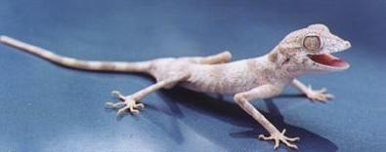
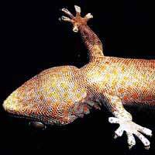
Geckos’ Climbing Ability
Hanging upside down on a plate of glass
Notes:
Curricular connections: biology, chemistry (molecular forces), materials science (new adhesive)

Slide 52
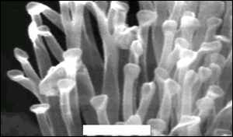
Van der Waals molecular forces due to size of gecko setae
Gecko setae
(white scale bar
= 1 micrometer)
Source: Autumn et al. (2002) Proceedings of the National Academy of Sciences.
Notes:
Setae pronounced “See’ – tee”. Many bacteria are in the 3-5 micron size range.
Curricular connections: biology, chemistry (molecular forces), materials science (adhesive)

Slide 53
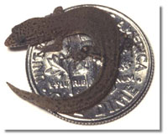
Littlest Lizard
If not kept moist, quickly dies from dessication due to relatively large surface area.
Source: (2002) The Science Teacher

Slide 54
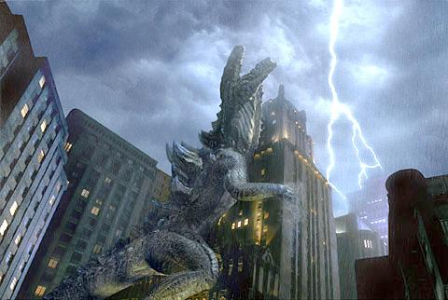
Biggest Lizard
Notes:
Poor girl looks upset about scaling laws.

Slide 55
Bone strength ~ cross-sectional area Load ~ weight
humans - 7.2 to 7.5 N/cm²
elephant - 7.47 N/cm²
Godzilla - ???
Notes:
Human bone would have to support about 85,000 lbs to be equivalently strong.
Curriculum connections: biology, physics

Slide 57
Bone strength ~ cross-sectional area Load ~ weight
humans - 7.2 to 7.5 N/cm²
elephant - 7.47 N/cm²
Godzilla – 3800 N/cm²
500 times greater than bone for other creatures!
Notes:
Human bone would have to support about 85,000 lbs to be equivalently strong.
Curriculum connections: biology, physics

Slide 59
Lead Partners
Notes:
The organizations that are formally engaged as lead partners in the development of the NGSS are Achieve, NRC, AAAS, and NSTA. Find logo for AAAS (Sue)

Slide 60
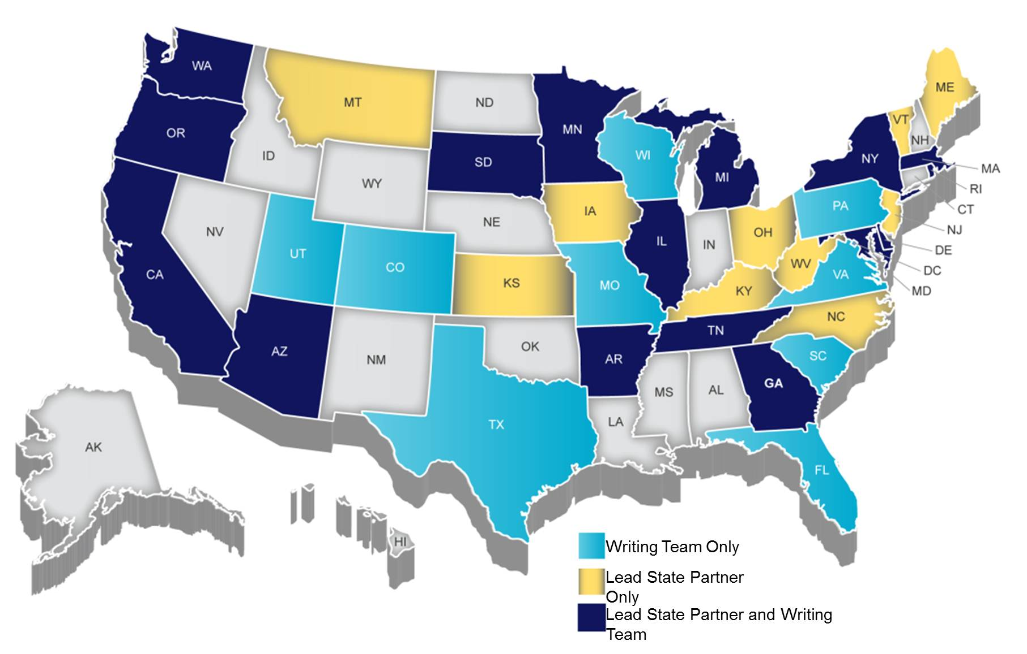
NGSS Lead States
Notes:
26 states have volunteered to be lead states in the development of NGSS: Arizona, Arkansas California, Delaware, Georgia, Illinois, Iowa, Kansas, Kentucky, Maine, Maryland, Massachusetts, Michigan, Minnesota, Montana, New Jersey, New York, North Carolina Ohio, Oregon, Rhode Island, South Dakota, Tennessee, Vermont, Washington and West Virginia.
Lead states have agreed to seriously consider adoption of NGSS once they are complete at the end of 2012.
Lead states have created committees that are responsible for reviewing and providing feedback about drafts versions of NGSS to Achieve.

Slide 61
Building from research & key reports…
1990s
1990 – 2009
Notes:
Many of these studies and the reports that resulted from them come from the National Research Council, the working arm of the National Academy of Sciences. Each has made a critical, often ground breaking contribution to our collective understanding of learning in the context of science. The Framework for K-12 Science Education that we are discussing with you today is constructed around many of the research-based ideas on learning, science, teaching, and cognitive development found in these reports. The Framework is based on a well-respected corpus of evidence.

Slide 62
The Framework is built on the notion of learning as a developmental progression. It is designed to help children continually build on and revise their knowledge and abilities, starting from their curiosity about what they see around them and their initial conceptions about how the world works.
Framework 1-3
Notes:
The goal is to guide student knowledge toward a more scientifically based and coherent view of the natural sciences and engineering, as well as of the ways in which they are pursued and their results can be used (Framework, p. 1-3).

Slide 63
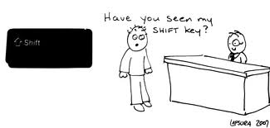
K-12 Science education should reflect the interconnected nature of science practiced and experienced in the real world.
The NGSS are student performance expectations – NOT curriculum. They guide curriculum and instruction decisions at the local level.
The science concepts build coherently from grade to grade.
The NGSS focus on deeper understanding of content as well as application of content in real-world phenomena.
Science and Engineering are integrated in the NGSS from K–12.
The NGSS are aligned with the Common Core State Standards to ensure students have foundational skills to read for understanding, communicate their learning, and utilize mathematical thinking to support scientific investigations and inquiry.
Notes:
2nd item is critical – stress that NGSS is about student performance expectations, but does not specify instruction, materials, structure of courses, etc. This should also address that such decisions about controversial topics, such as climate change and evolution, are addressed through less controversial content expectations and through practices, but are in the hands of local districts about how they are taught.
The connections (item 1), depth and application (item 4) do not replace content, as has been misconstrued by some, but rather, they add dimensions to the content to ensure it is connected and addresses greater depth of knowledge.
Alignment with CCSS means that references to math concepts or literacy practices are referenced, and that it sets a foundation for connection across disciplines without specifying HOW this would be done (again, set at local sites)

Slide 64
Structure of the Framework:
The Framework establishes three dimensions of science learning:
Science and Engineering Practices
Crosscutting Concepts
Disciplinary Core Ideas
Notes:
The framework establishes three dimensions of learning that are also reflected in the structure of the NGSS. The 1-2-3. the NGSS are intended to be a blending of these three dimensions which represents a significant switch in the way science is often taught using the previous KCAS standards developed in the 90s.

Slide 65
Science and Engineering Practices
1. Asking questions (science) and defining problems (engineering)
2. Developing and using models
3. Planning and carrying out investigations
4. Analyzing and interpreting data
5. Using mathematics, information and computer technology, and computational thinking
6. Constructing explanations (science) and designing solutions (engineering)
7. Engaging in argument from evidence
8. Obtaining, evaluating, and communicating information
Notes:
Critical practices necessary in order for students to become a scientifically literate citizen in the 21st Century

Slide 66
Seven Crosscutting Concepts
Patterns
Cause and effect
Scale, proportion, and quantity
Systems and system models
Energy and matter
Structure and function
Stability and change
Notes:
The seven CC represent ideas that cut across several domains of science and are not specific to one. For example patterns can be found in the chemistry as we observe the elements of the periodic table as well as patterns noted as we observe and classify living organisms. These seven cc are critical to science but do not belong solely to one domain in science. These are the thread that weave together all the domains of science across all grade levels.

Slide 67
Disciplinary Core Ideas
Life Science | Physical Science
LS1: From Molecules to Organisms: Structures and Processes LS2: Ecosystems: Interactions, Energy, and Dynamics LS3: Heredity: Inheritance and Variation of Traits LS4: Biological Evolution: Unity and Diversity | PS1: Matter and Its Interactions PS2: Motion and Stability: Forces and Interactions PS3: Energy PS4: Waves and Their Applications in Technologies for Information Transfer
Earth & Space Science | Engineering & Technology
ESS1: Earth’s Place in the Universe ESS2: Earth’s Systems ESS3: Earth and Human Activity | ETS1: Engineering Design ETS2: Links Among Engineering, Technology, Science, and Society
Notes:
The final dimension of the Framework is the DCIs. This is probably the most familiar to science folks as these reflect the content of science. There are four major DCIs….. The ETAS DCI is considered a newer concept due to fact that very few science standard of the past included ETAS. This is an attempt to validate the importance of engineering and design in applying science in today’s society. The ETAS DCIs are integrated in the other three domains in elementary but can also be found on a separate page to emphasis that ETAS should be a part of all instructional practices

Slide 68
Standards = 3 Dimensions
Not separate treatment of “content” and “inquiry”
Curriculum and instruction needs to do more than present and assess scientific ideas – they need to involve learners in using scientific practices to develop and apply the scientific ideas.
Crosscutting Concepts
Core
Ideas
Practices
Notes:
The intent of the NGSS is to take the 3 dimensions of the Framework and blend them together to create a stronger set of standards that no longer permit separate standards for content and inquiry. You know what is said about a cord of three…

Slide 70
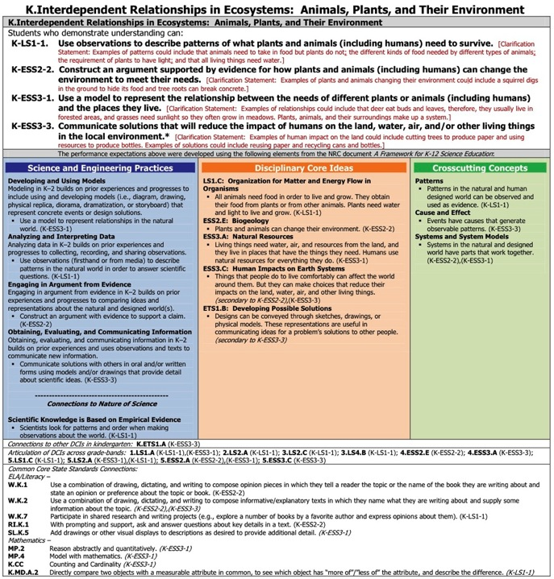

Slide 71
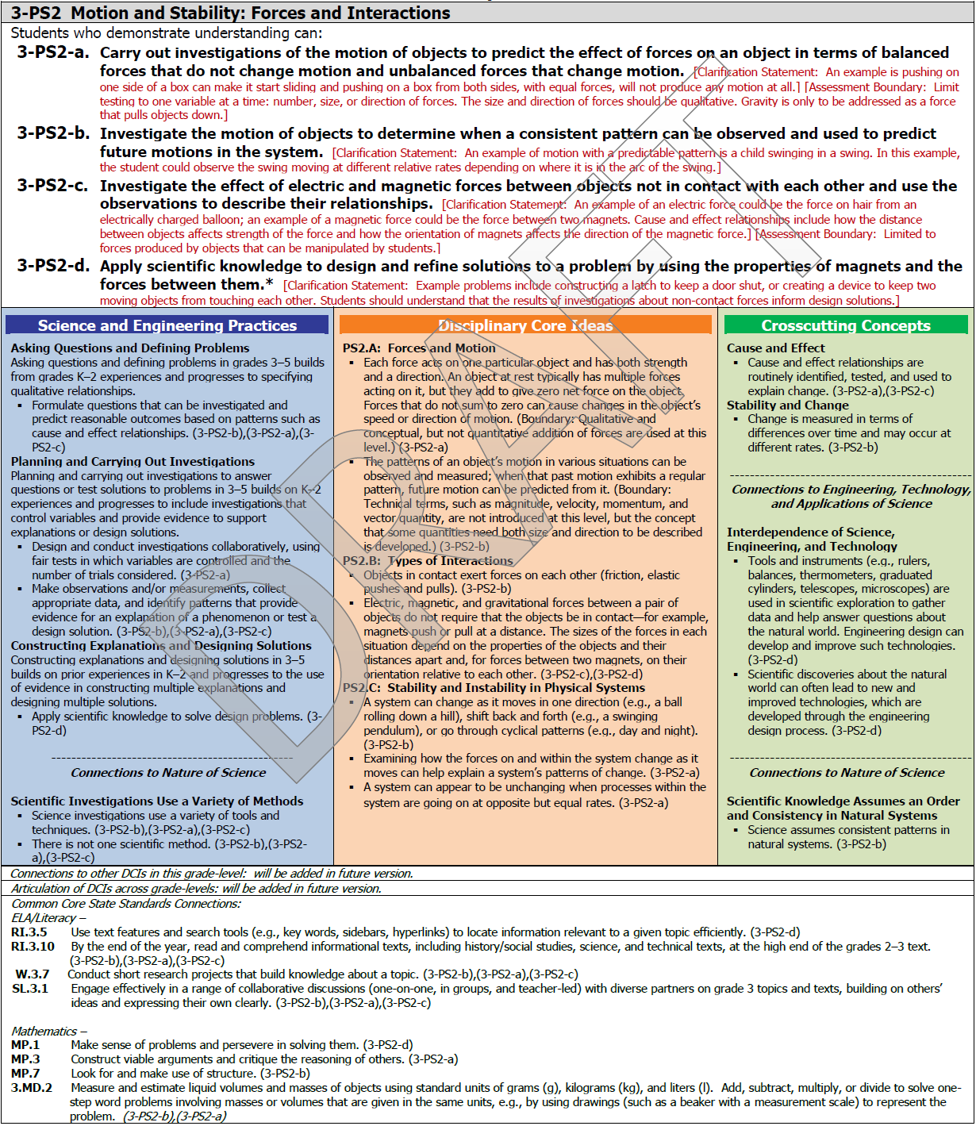
Inside the NGSS Box
Title and Code The titles of standard pages are not necessarily unique and may be reused at several different grade levels . The code, however, is a unique identifier for each set based on the grade level, content area, and topic it addresses.
What is Assessed A collection of several performance expectations describing what students should be able to do to master this standard
Foundation Box
The practices, core disciplinary ideas, and crosscutting concepts from the Framework for K-12 Science Education that were used to form the performance expectations
Connection Box
Other standards in the Next Generation Science Standards or in the Common Core State Standards that are related to this standard
Based on the January 2013 Draft of NGSS

Slide 72
Inside the NGSS Box
Scientific & Engineering Practices Activities that scientists and engineers engage in to either understand the world or solve a problem
Foundation Box
The practices, core disciplinary ideas, and crosscutting concepts from the Framework for K-12 Science Education that were used to form the performance expectations
Disciplinary Core Ideas Concepts in science and engineering that have broad importance within and across disciplines as well as relevance in people’s lives.
Crosscutting Concepts Ideas, such as Patterns and Cause and Effect, which are not specific to any one discipline but cut across them all.
Connections to Engineering, Technology and Applications of Science These connections are drawn from the disciplinary core ideas for engineering, technology, and applications of science in the Framework.
Connections to Nature of Science Connections are listed in either the practices or the crosscutting connections section of the foundation box.
Based on the January 2013 Draft of NGSS

Slide 73
Inside the NGSS Box
Scientific & Engineering Practices Activities that scientists and engineers engage in to either understand the world or solve a problem
Foundation Box
The practices, core disciplinary ideas, and crosscutting concepts from the Framework for K-12 Science Education that were used to form the performance expectations
Disciplinary Core Ideas Concepts in science and engineering that have broad importance within and across disciplines as well as relevance in people’s lives.
Crosscutting Concepts Ideas, such as Patterns and Cause and Effect, which are not specific to any one discipline but cut across them all.
Based on the January 2013 Draft of NGSS

Slide 74
Inside the NGSS Box
Foundation Box
The practices, core disciplinary ideas, and crosscutting concepts from the Framework for K-12 Science Education that were used to form the performance expectations
Connections to Engineering, Technology and Applications of Science These connections are drawn from the disciplinary core ideas for engineering, technology, and applications of science in the Framework.
Connections to Nature of Science Connections are listed in either the practices or the crosscutting connections section of the foundation box.
Based on the January 2013 Draft of NGSS

Slide 75
Inside the NGSS Box
Performance Expectations A statement that combines practices, core ideas, and crosscutting concepts together to describe how students can show what they have learned.
Clarification Statement A statement that supplies examples or additional clarification to the performance expectation.
What is Assessed A collection of several performance expectations describing what students should be able to do to master this standard
Assessment Boundary A statement that provides guidance about the scope of the performance expectation at a particular grade level.
Engineering Connection (*) An asterisk indicates an engineering connection in the practice, core idea or crosscutting concept that supports the performance expectation.
Based on the January 2013 Draft of NGSS

Slide 76
Inside the NGSS Box
Codes for Performance Expectations Codes designate the relevant performance expectation for an item in the foundation box and connection box. In the connections to common core, italics indicate a potential connection rather than a required prerequisite connection.
Based on the January 2013 Draft of NGSS

Slide 77
Inside the NGSS Box
Title and Code The titles of standard pages are not necessarily unique and may be reused at several different grade levels . The code, however, is a unique identifier for each set based on the grade level, content area, and topic it addresses.
Performance Expectations A statement that combines practices, core ideas, and crosscutting concepts together to describe how students can show what they have learned.
Clarification Statement A statement that supplies examples or additional clarification to the performance expectation.
What is Assessed A collection of several performance expectations describing what students should be able to do to master this standard
Assessment Boundary A statement that provides guidance about the scope of the performance expectation at a particular grade level.
Engineering Connection (*) An asterisk indicates an engineering connection in the practice, core idea or crosscutting concept that supports the performance expectation.
Scientific & Engineering Practices Activities that scientists and engineers engage in to either understand the world or solve a problem
Foundation Box
The practices, core disciplinary ideas, and crosscutting concepts from the Framework for K-12 Science Education that were used to form the performance expectations
Disciplinary Core Ideas Concepts in science and engineering that have broad importance within and across disciplines as well as relevance in people’s lives.
Crosscutting Concepts Ideas, such as Patterns and Cause and Effect, which are not specific to any one discipline but cut across them all.
Connection Box
Other standards in the Next Generation Science Standards or in the Common Core State Standards that are related to this standard
Connections to Engineering, Technology and Applications of Science These connections are drawn from the disciplinary core ideas for engineering, technology, and applications of science in the Framework.
Connections to Nature of Science Connections are listed in either the practices or the crosscutting connections section of the foundation box.
Codes for Performance Expectations Codes designate the relevant performance expectation for an item in the foundation box and connection box. In the connections to common core, italics indicate a potential connection rather than a required prerequisite connection.
Based on the January 2013 Draft of NGSS

Slide 79
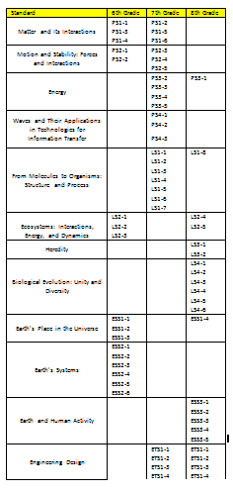
NGSS Conceptual Progressions Model for Middle School
This model reflects an integrated approach that includes life, earth and physical science concepts in every grade
Presented to KBOE
Recommended model
See Appendix K of NGSS for
more information.
Notes:
Not sure if you want this in here but might come up ….

Slide 80
SC-EP-1.2.1
Students will describe and make inferences about the interactions of magnets with other magnets and other matter (e.g., magnets can make some things move without touching them).
Magnets have observable properties that allow them to attract and repel each other and attract certain kinds of other materials (e.g., iron). Based on the knowledge of the basic properties of magnets, predictions can be made and conclusions drawn about their interactions with other common objects.
DOK 3
Notes:
Not sure if you want this in here but might come up ….

Slide 81
It’s time for $20,000 Pyramid!

Slide 82
Group A terms
Performance Expectations
Science & Engineering Practices
Clarification Statement
Framework

Slide 83
Group B terms
Assessment Boundary
Cross Cutting Concept
Engineering Design
Connection Boxes

Slide 84
Exploring a Performance Expectation
Activity:
You are to complete the exploration chart using one of the PEs at the top of the page that corresponds with the grade level you teach or one that is of interest to you. Feel free to work with others.
Begin by finding the Disciplinary Core Idea (DCI) for that PE, and work your way through the NGSS to find locate the other components noted on the chart.
If you finish one PE, try repeating the process for another PE.
Notes:
A lot of information has been shared with you regarding the background information and structure of the NGSS. Now it is your turn to take some time to explore the NGSS document for yourself.

Slide 85
Table Talk
Time to share at your table what you learned about the PEs as a result of your exploration.
Plan to report out the following:
We wonder…
We noticed…
Our greatest AH HA was…
We all found…
We are concerned about…
The NGSS…
Notes:
This will give us some understanding as to what teachers are thinking

Slide 86
Time to Ponder…
Implications for Instruction:
How will the information you learned about the NGSS today impact your instruction?
Respond on the provided card.

Slide 87
Speed bumps on the road to NGSS
Notes:
Revise title slide to add in MI STEM Partnership logo? Use these logos as the common slide template?

Slide 88
Old dullness can trump new standards

Slide 89
5-LS1-1. Support an argument that plants get the materials they need for growth chiefly from air and water. [Clarification Statement: Emphasis is on the idea that plant matter comes mostly from air and water, not from the soil.]
Read some stuff
Do some worksheets
Write an argumentative passage
Answer an ORQ
Take it on faith
Read some stuff
Grow some plants and measure soil mass before/after
Write an argumentative passage
Prove it to yourself

Slide 90
HS-PS2-6. Communicate scientific and technical information about why the molecular-level structure is important in the functioning of designed materials.
Read some stuff
Do some worksheets
Write report with data tables or diagrams
Answer an ORQ
Take it on faith
Read some stuff
Conduct investigations using compounds of varied structures…
Select an appropriate format…
Prove it to yourself

Slide 95
Crosswalk?

Slide 96
Avoid the folder swap

Slide 97
“The new standards don’t really impact me very much because I teach high school but I don’t teach biology”

Slide 98
The nebular theory of curriculum accretion in action

Slide 99
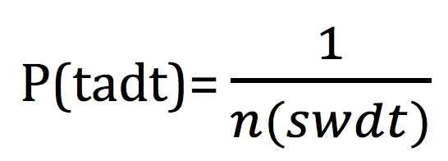
“We already do that”

Slide 100
Death march through the bullets

Slide 101
http://youtu.be/GO6B1K1ciBI

Slide 102
District Planning

Slide 103
Plan, Do, Review
Plan:
What will I do with what I have learned in this network meeting?
Do:
When, where, how, with whom will I do what I have planned?

Slide 104
Gallery Walk
Chart Paper:
Synthesize School/District Plans
Gallery Walk:
Inspirations?
Take Aways?

Slide 105
Follow up
Determine who else is on the District Leadership Team
Read/review the Framework for K-12 Science Education and the NGSS
Explain your role in the Network to one or more of your colleagues
Recycle a Binder (or ask for one)
Look for an email with a link to resource page

Slide 106
Meeting dates
October 29
November 22*
January 30
February 27
March 27

Slide 107
Comments and Questions
http://www.nextgenscience.org
http://concord.org/publications/newsletter/2013-spring/ngss-path
http://www.nsta.org/about/standardsupdate/
http://teachscience4all.wordpress.com/
(1 page document that links all of the NGSS webinars and recourses from NSTA)

