Slide 1
Science Network
Meeting
January 30, 2014
Welcome!
Please make sure you pick up one copy of each handout from the table before we begin
Notes:
Science—and therefore science education—is central to the lives of all Americans, preparing them to be informed citizens in a democracy and knowledgeable consumers. It is also the case that if the nation is to compete and lead in the global economy and if American students are to be able to pursue expanding employment opportunities in science-related fields, all students must all have a solid K–12 science education that prepares them for college and careers

Slide 2
Team Norms- Learning Forward

Slide 3
Goals for the day
Reflect on impact of unit redesign to incorporate the SEP
Review/extend learning related to learning targets derived from the standards
Engage in creation of model progression of learning targets K-8 + HS
Begin consideration of assessment design related to the 3-D nature of the standards
Revisit leadership goals and priorities

Slide 4
Network Vision
“Every school district in the Commonwealth of Kentucky has a knowledgeable and cohesive leadership team that guides the professional learning and practice of all administrators, teachers, and staff so that every student experiences highly effective teaching, learning, and assessment practices in every classroom, every day.”

Slide 5
Building Capacity Around the 4 Pillars

Slide 6
The Four Pillars of the content networks
Standards
Educational Leadership
Assessment Literacy
Characteristics of Highly Effective Teaching and Learning (CHETL)

Slide 7
Continuous formative assessment & virtual parking lot
http://padlet.com/wall/OVECSTLN0114

Slide 8
Follow up from November evaluations
What was the most valuable part of the day?
Working with similar content area teachers to discuss implementing the practices (most)
Practice deconstructing a PE
Establishing cell partners for networking

Slide 9
Follow up from November evaluations
What suggestions do you have for the next meeting’s agenda?
More time to work with mitochondrion (role alike) partners on unit refinement/development
Less Stiggins, more content
Working on integrating KCAS science with biology EOC requirements

Slide 10
Follow up from November evaluations
What questions/concerns do you still have?
Still not sure how to mesh the 8 Practices with the content in my current units
When will biology EOC match KCAS for science?
Need more information specific to my grade level
Would like to develop a suggested timeline for what districts could roll out in January 2014
When will this realistically get implemented?

Slide 11
Sharing Redesigned Units
What?
Take 4 minutes to share what you did. Group members may ask clarifying questions.
So what?
Take 2 minutes to interpret. What was the impact? On the students? On you/your practice?
Now what?
Take 3 minutes to discuss next steps. Welcome suggestions from your colleagues.

Slide 12
Learning/Achievement Targets
Statements of what we want students to learn and be able to do.

Slide 13
Why learning targets?
If TEACHERS don’t explicitly know what the standards require students to learn, how can they intentionally plan for them to learn it?
If TEACHERS don’t explicitly know what the standards require students to learn, how can they design assessments to tell them if their students are learning it?
If STUDENTS don’t know what they are supposed to learn, how can they tell they are making progress toward learning it?

Slide 14
Clear Targets
Impact on students:
More focused (especially underachieving students).
Develops a learning culture.
Quality of work improves.
Behavior improves.
Persevere longer.
Greater ownership of learning as responsibility shifts from teacher to student.
More likely to express learning needs – specifically.
Automatically self-evaluative.
More enthusiastic about learning.

Slide 15
Clear Targets
Impact on teachers:
Congruent to the standard vs. loosely correlated
Expectations rise.
Focus on quality rather than getting everything done.
More critical of activities.
Reinforces most important vocabulary rather than exhaustive lists of related words.
Assists in reflection of lesson and learning that occurred.
Strengthen connections with parents related to child’s strengths and weaknesses.

Slide 16
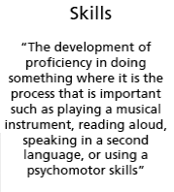
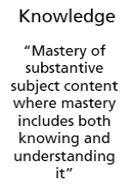
Classifying Targets

Slide 18
Attributes of Clear Targets
Learning targets (are): …as opposed to:
Accomplished in a few days at most
Long term
Specific to the what and how (clear indication of desired performance or knowledge; it is apparent to the teacher and learner when it has been accomplished)
Global and somewhat ambiguous (May be without criteria for successful achievement/expected behaviors) OR of such a large ‘grain size’ that it requires achieving multiple, scaffolded targets to attain
Usually consist of a concept (noun), skill (verb) and often a specified context.
Lacking one or more of the components

Slide 19
Learning targets (are): …as opposed to:
Teachable/learnable using a variety of instructional activities/strategies/contexts/tools.
A single approach or activity is the only approach possible with the given target; not transferrable to another context
One component in a sequence of scaffolded accomplishments
Focused on what is to be LEARNED
Only focused on what is to be DONE (activity)

Slide 20
The ultimate evaluation criteria for learning targets:
“If my students can successfully meet all of these individual targets, will they have met the full intent of the standard?”

Slide 21
Target vs Activity
A target is an idea that might be taught several ways
An activity is one way an idea might be taught

Slide 22
Target or Activity?
Distinguish between kinetic and potential energy.
Target
Model radioactive decay by counting pennies that land face-up to represent nuclear fission.
Activity
Write a lab report describing the technique used to investigate melting point
Activity

Slide 23
Target or Activity
Communicate the procedure and results of an investigation I designed to investigate the effects of pushes and pulls
Target
Circle the words that should be capitalized in the following paragraph.
Activity
Classify evidence by how well it supports an argument based on specified criteria.
Target

Slide 24
Learning Target or Not? You Be the Judge
I can identify the protagonist, theme, and voice of a piece of literature.
I can compare factors contributing to the French Revolution and the American Revolution.
I can describe how materials change when they are heated or cooled.
I can flip a coin one hundred times to determine the probability of heads.
I can summarize what I have read or learned. This means I can write a short statement of the main points or the big ideas of what I read or learned.
I can use authentic ancient Egyptian techniques to mummify a chicken.

Slide 25
Target Q & A
Why can’t we just start writing units?
“Pruitt said they don’t need unpacking”
What’s a product?
Why doesn’t KDE just give us the targets?
Other?

Slide 26
Why learning targets?
If TEACHERS don’t explicitly know what the standards require students to learn, how can they intentionally plan for them to learn it?
If TEACHERS don’t explicitly know what the standards require students to learn, how can they design assessments to tell them if their students are learning it?
If STUDENTS don’t know what they are supposed to learn, how can they tell they are making progress toward learning it?

Slide 27
The ultimate evaluation criteria for learning targets:
“If my students can successfully meet all of these individual targets, will they have met the full intent of the standard?”

Slide 28
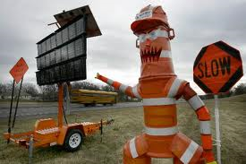
Put on your hard hats! Zone A head!
RE-
AHEAD

Slide 29
If our targets are aligned, we should be able to identify the PE!
Notes:
Joy McTeigh modeled “backwards deconstruction” in his recent webinar. This made those of us viewing the webinar to say “that really makes sense”. If we truly understand the intent of the PE and have closely aligned our learning targets to the intended outcome of the PE, then we should be able to look at the targets collectively and determine the aligned PE. We would reverse the path of the flow chart….
Let’s try this process together.
Reference the Nile River (flows south to north to Mediterranean Sea)

Slide 30
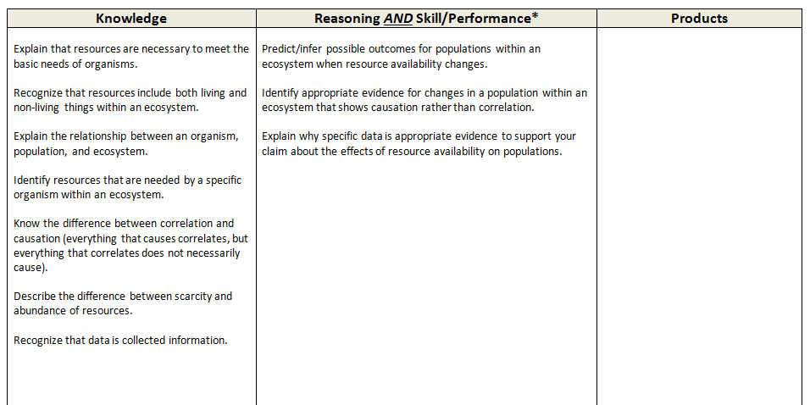
At First Glance…
Recognize that patterns in data might describe a causal relationship between 2 factors in an ecosystem.
SEP? DCI? XCC?
Notes:
Create game atmosphere…
Guide participants through reconstruction using guiding questions in red (only use charts of dimensions- no looking in books or using any other tools! ) Show chart of SEP. Ask for evidence of SEP choice. Share thinking. Repeat with DCI and XCC using charts only. Write each dimension on index card then create PE. Table share to create one common PE.
Not perfect…share process of revising several times…
After first glance, look at each component in progressions. Revise thinking on card.
Find corresponding PE
06-LS2-1.
Analyze and interpret data to provide evidence for of resource availability on organisms and populations of organisms in an ecosystem. [Clarification Statement: Emphasis is on cause and effect relationships between resources and growth of individual organisms and the numbers of organisms in ecosystems during periods of abundant and scarce resources.]

Slide 31
Partner Reconstruction
Meet up with you Vacuole Partner to work through this process again using the PE deconstruction homework your completed. (We have other examples if you need one for this task.)
Using this same process of “working backwards”, engage in the “reconstruction” without tools to determine if the targets listed will move students toward mastery of the specific PE. (15 minutes)
Notes:
15 min...If using HW- fold back top section.
Emphasis on looking for evidence of the 3 dimensions - First Glance!
THEN use tools (standards, progressions and framework). Write possible PE.
Encourage all to add thinking to flowchart and target page…missing targets? Revise targets? Voc. of targets?

Slide 32
Be a critical (but kind) friend! Push back when needed in order to move our learning forward!
Look for evidence:
SEP
DCI
XCC
Use tools after you have given the task your best effort!
Are other targets needed? If so, please record them on the sheet.

Slide 33
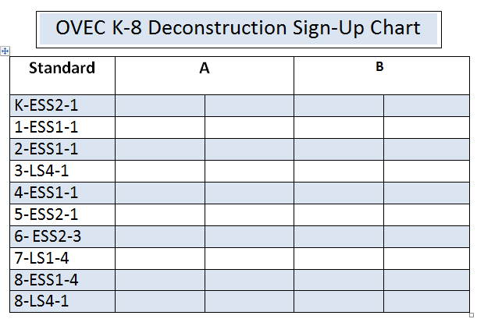
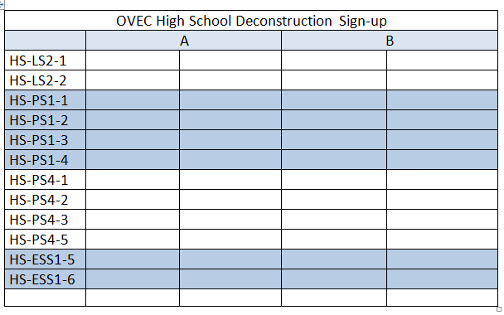
Divide and Conquer!
1st HS - choose PE from your content when possible.
All others :
Choose one PE from your grade level or within the grade band.
2nd K-2
3rd 3-5
4th 6-8
It is about the process!!

Slide 34
Notes:
Break and sign up

Slide 35
Lunch

Slide 36
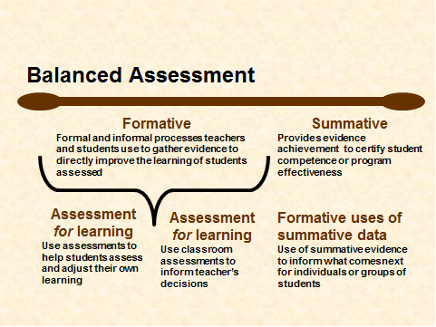
Notes:
Begin with a Review of Balanced Assessment Literacy
Address Learning Target: Articulate the importance of a balanced assessment system in planning, implementing and assessing the new science standards.

Slide 37
Key Characteristics of Assessment Literacy
Key 1
Clear Purpose
Key 2
Clear Targets
Key 3
Sound Design
Key 4
Effective Communication
Key 5
Student Involvement
Notes:
The first discussion round refers to the 5 Key Characteristics of Assessment Literacy. (Text page 5). All of the pieces contributing to sound classroom assessment instruments and practices are built on a foundation of the following five keys to quality. Key 1 They have a clear purpose…they are designed to serve the specific information needs of intended uses. Key 2 they are based on clearly articulated and appropriate achievement targets, Key 3…accurately measure student achievement, Key 4…yield results that are effectively communicated to users, and Key 5 involves the student in self-assessment, goal setting, tracking, reflecting on and sharing their learning)

Slide 38
Key 3: Sound Assessment Design
Select a proper method
Select or create quality items, tasks, and rubrics
Sample appropriately
Prevent bias
Design assessments so students can self-assess and set goals based on the results
Notes:
Slide 40
“High-quality assessments are not built first and then retro-fitted into a context. After we have established the purpose and identified the learning targets to be assessed, then we are ready to (read slide).”

Slide 39
Possible Assessment Methods
Selected Response
Multiple Choice
True/False
Matching
Fill in
Extended Written Response
Performance Assessment
Personal Communication
Questions
Conferences
Interviews
Notes:
Slide 41
“The assessment methods available to us fall into one of four categories: (read slide). The methods are not interchangeable; some fit some contexts but not others. No method is inherently superior to the others. All are viable choices, depending on two variables: purpose—Who will use the information? What decisions will it inform? and target—What kind of learning do you want to assess?”

Slide 40
Classroom Assessment Strategies
Selected Response
Constructed
Response
Performance Assessment
Observations/
Conversations
Multiple Choice
True-False
Matching
Diagram
Fill-in-the-blank (words, phrases)
Essay
Short answer (sentences, paragraphs)
Web
Concept Map
Flowchart
Graph
Table
Matrix
Illustration
Presentation
Movement
Science lab
Athletic skill
Dramatization
Enactment
Project
Debate
Model
Exhibition
Recital
Performance Task
Oral questioning
Observation
Interview
Conference
Process description
Checklist
Rating scale
Journal sharing
Thinking aloud a process
Student self-assessment
Peer review
Adapted from the work of Dr. Robert Marzano

Slide 41
Classroom Assessment Strategies
Selected Response
Constructed
Response
Performance Assessment
Observations/
Conversations
Multiple Choice
True-False
Matching
Diagram
Fill-in-the-blank (words, phrases)
Essay
Short answer (sentences, paragraphs)
Web
Concept Map
Flowchart
Graph
Table
Matrix
Illustration
Presentation
Movement
Science lab
Athletic skill
Dramatization
Enactment
Project
Debate
Model
Exhibition
Recital
Performance Task
Oral questioning
Observation
Interview
Conference
Process description
Checklist
Rating scale
Journal sharing
Thinking aloud a process
Student self-assessment
Peer review
Adapted from the work of Dr. Robert Marzano

Slide 42
Classroom Assessment Strategies
Selected Response
Constructed
Response
Performance Assessment
Observations/
Conversations
Multiple Choice
True-False
Matching
Diagram
Fill-in-the-blank (words, phrases)
Essay
Short answer (sentences, paragraphs)
Web
Concept Map
Flowchart
Graph
Table
Matrix
Illustration
Presentation
Movement
Science lab
Athletic skill
Dramatization
Enactment
Project
Debate
Model
Exhibition
Recital
Performance Task
Oral questioning
Observation
Interview
Conference
Process description
Checklist
Rating scale
Journal sharing
Thinking aloud a process
Student self-assessment
Peer review
Adapted from the work of Dr. Robert Marzano

Slide 43
Classroom Assessment Strategies
Selected Response
Constructed
Response
Performance Assessment
Observations/
Conversations
Multiple Choice
True-False
Matching
Diagram
Fill-in-the-blank (words, phrases)
Essay
Short answer (sentences, paragraphs)
Web
Concept Map
Flowchart
Graph
Table
Matrix
Illustration
Presentation
Movement
Science lab
Athletic skill
Dramatization
Enactment
Project
Debate
Model
Exhibition
Recital
Performance Task
Oral questioning
Observation
Interview
Conference
Process description
Checklist
Rating scale
Journal sharing
Thinking aloud a process
Student self-assessment
Peer review
Adapted from the work of Dr. Robert Marzano

Slide 44
Classroom Assessment Strategies
Selected Response
Constructed
Response
Performance Assessment
Observations/
Conversations
Multiple Choice
True-False
Matching
Diagram
Fill-in-the-blank (words, phrases)
Essay
Short answer (sentences, paragraphs)
Web
Concept Map
Flowchart
Graph
Table
Matrix
Illustration
Presentation
Movement
Science lab
Athletic skill
Dramatization
Enactment
Project
Debate
Model
Exhibition
Recital
Performance Task
Oral questioning
Observation
Interview
Conference
Process description
Checklist
Rating scale
Journal sharing
Thinking aloud a process
Student self-assessment
Peer review
Adapted from the work of Dr. Robert Marzano

Slide 45
So now what?
Types of learning targets
What learning targets assess
Types of assessment methods
Matching the most appropriate method of assessment with each type of learning target…

Slide 46
Target/Method Match

Slide 47
Target/Method Match
Target | Selected Response | Extended Written Response | Performance Assessment | Observation/ Conversation
Knowledge | Yes! | Yes-Understandings of relationships among elements of knowledge | Nope- too time consuming | Maybe (question, evaluate answers, infer mastery –but time consuming

Slide 48
Target/Method Match
Target | Selected Response | Extended Written Response | Performance Assessment | Observation/ Conversation
Product | No | Maybe-if product is written | Yes! | No

Slide 49
Developing Assessments for Next Generation Science Standards

Slide 50
Assessment to Demonstrate Learning Did We Hit the Mark?
Using the anonymous assessment given to you, generate a list of learning targets that you feel this assessment addresses.
Categorize into Knowledge, Reasoning/Skill, Product
Notes:
20 min

Slide 51
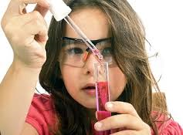
BOTA Report
Board On Testing And Assessment
Read and reflex upon Developing Assessments for the Next Generation Science Standards using the Say Something Protocol

Slide 53
Say Something Protocol
Read “Introduction” and “A Closer Look At The Framework And Standards” (pgs. 1-2)—then say something to your partner
Read “Assessing Three Dimensional Learning” and “A Systems Approach to Assessment” (pgs. 2-3)—then say something to your partner
Read “Implementing the New Assessment System” and “Example: Assessing Three-Dimensional Learning” (pgs. 3-4)—then say something to your partner
Notes:
20 min = 5 intro/wrap-up + 5/reading

Slide 54
Assessment to Demonstrate Learning Moving to the Next Level
Reflecting upon the assessment you read earlier, consider the following
Do the types of questions on the assessment adequately measure learning as intended by NGSS?
What is missing?
Notes:
5 min

Slide 55
Create a Wanted Poster
Identify “Wanted” Characteristics found in classroom assessments that support the vision of learning found in the Next Generation Science Standards
Notes:
15 minutes

Slide 56
Meeting dates
February 27
March 27
Summer?

Slide 57
Taking it back (sharing the love)
District team
Develop specific, realistic goal(s) for sharing what you have learned with your school and/or district
Between today and January 30
What, when, measure of success

Slide 58
Follow up
Read Chapters 4-6 in the Classroom Assessment for Student Learning (CASL) book
Deconstruct a standard of your choosing (focusing on cause and effect) and share
Implement the revised unit you shared today
Bring an assessment you created to next meeting
Be on the lookout for a scheduling email
Go be a leader!

