Slide 1
Show me the evidence!!

Slide 2
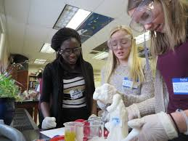
What is good practice? How do you know?
OVEC STLN
October 22, 2015

Slide 3
Agenda
Welcome
Norms
Chart PE for December
Analysis of Data
Break & Walkabout
Assessment Task
Task Analysis Protocol
Lunch (11:50-12:30)
Network Data
Effective PLC’s
NGSS in the Classroom
Task Development
Evaluation

Slide 4
Network Vision
Every school district in the Commonwealth of Kentucky has a knowledgeable and cohesive leadership team that guides the professional learning and practice of all administrators, teachers, and staff so that every student experiences highly effective teaching, learning and assessment practices in every classroom, every day.

Slide 5
NORMS
Pausing
Paraphrasing
Presume Positive Intentions
Posing Questions
Putting Ideas on the Table
Providing Data
Paying Attention to Self and Others

Slide 6
OVEC
October 22, 2015
All materials for today’s meeting can be found at http://ovecsln.weebly.com/

Slide 7
Year at a Glance

Slide 8
Use available and appropriate data to inform a cycle of continuous improvement.(district,
school, teacher, student)
(3,2)
Select/create assessments that yield evidence for a given purpose.(1,3))
Science
Goals for the DLT
Use established criteria, protocols, tools resources with fidelity to gauge professional practice and student learning. (1,4,8)
Analyze structures and systems used by effective DLT’s/PLC’s-what is high quality?
(6,7,8)
Utilize appropriate resources/protocols to facilitate deeper learning around specific content standards. (1)

Slide 9
What information about the students’ knowledge and skills are each item of the assessment gathering? What patterns do you notice in the student data? What should be the next steps for instruction based on the data?
Discussion Questions for 5th Grade TASK

Slide 10
https://todaysmeet.com/OCTSTLN
Log into TODAY’S MEET and post the Pluses (positives) for this task and the Deltas(things you would like to change).

Slide 11
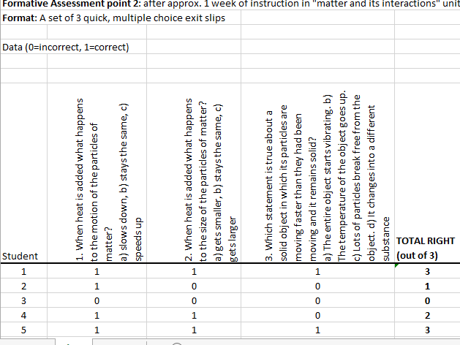

Slide 12
06-PS1-4. Develop a model that predicts and describes changes in particle motion, temperature, and state of a pure substance when thermal energy is added or removed. [Clarification Statement: Emphasis is on qualitative molecular-level models of solids, liquids, and gases to show that adding or removing thermal energy increases or decreases kinetic energy of the particles until a change of state occurs. Examples of models could include drawings and diagrams. Examples of particles could include molecules or inert atoms. Examples of pure substances could include water, carbon dioxide, and helium.]

Slide 13
Use sticky note to provide ideas for phenomenon/problems related to performance expectations

Slide 14
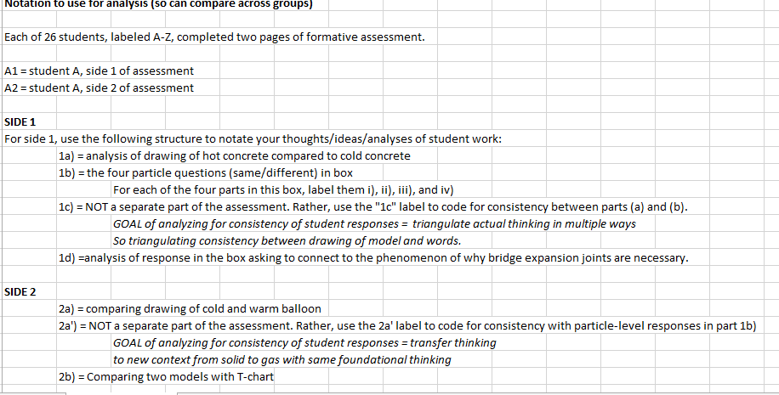
6th Grade Task Analysis

Slide 15
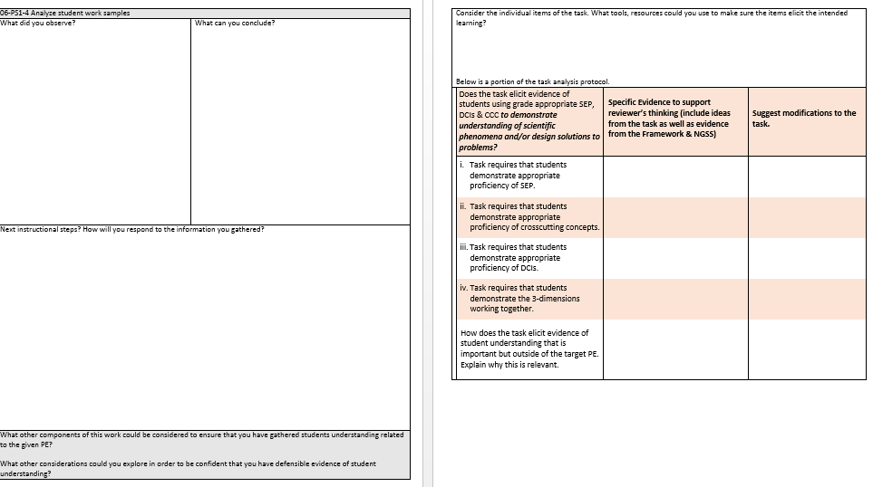
Task Analysis

Slide 17
Connections from September. . .
6. My District Leadership Team meets regularly to reflect on and refine our plan for scaling and sustaining highly effective teaching, learning and assessment practices district-wide based on new learning and relevant information/data.
ISLN 4.2 STLN 2.9 SSTLN 2.7

Slide 18
What questions do you still have related to your district leadership team’s capacity to implement KAS within the context of highly effective teaching, learning and assessment practices?
-What is my district leadership team doing? Who is on my district leadership team?
Science Network
We need help spreading this across our whole district.
I can take back resources and strategies, but I’m a little concerned about doing that since I’ve never met with our DLT.
What is my role for my district?
How will our DLT guarantee the standards are carried out?
How can I help others in my district with NGSS?
What do they expect us to do on/within the district this last year?

Slide 19
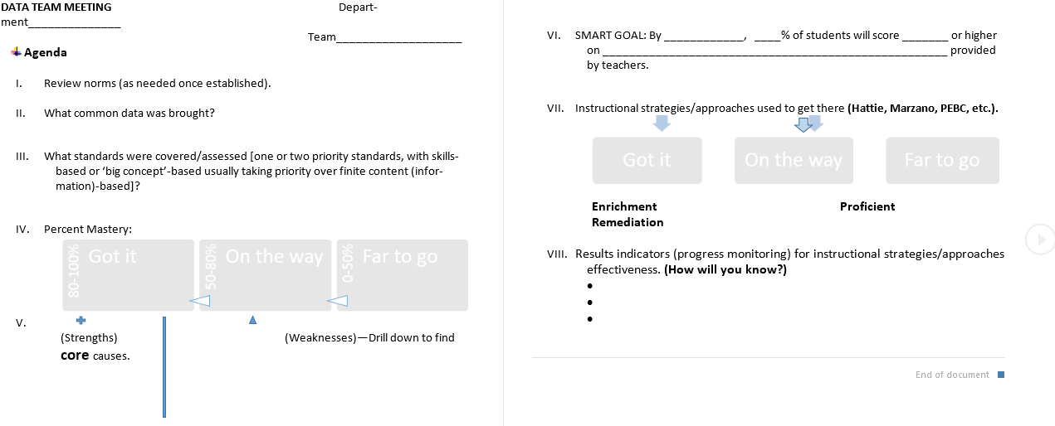
PLC’s Example Agenda

Slide 20
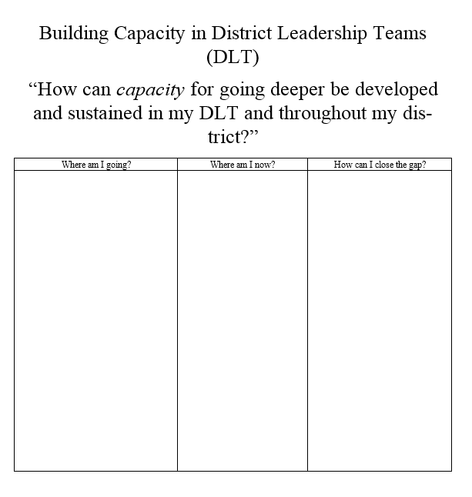

Slide 21
What does good practice look like in a NGSS classroom?
What should a visitor to your classroom expect to observe if he/she walked into a science classroom at your school?
What are your “look fors” as you observe science teaching?

Slide 22
What does good practice look like in the NGSS classroom?
https://www.teachingchannel.org/videos/cross-discipline-lesson-achieve

Slide 23
Questions to Consider????
How does Ms. Shelton make the crosscutting concepts explicit in the classroom?
What about this classroom looks different from a “traditional” lab experience? What evidence can you see of how this shift impacts student learning?
How does Mrs. Shelton empower her students to lead their own learning?

Slide 24
What does good practice look like in the NGSS classroom?
What new understandings do you have about what a NGSS classroom looks like?
Have your “look fors” changed? What is different and why?

Slide 25
Science
What is good practice? How do you know?

Slide 26
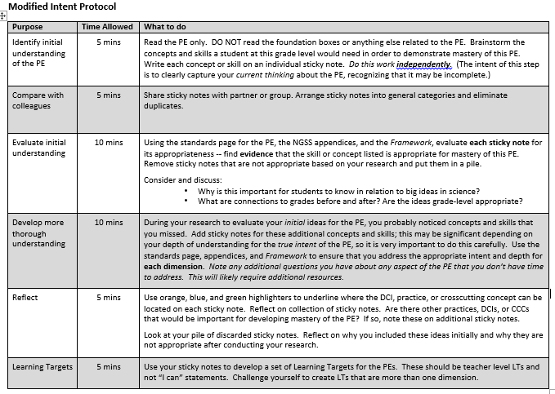

Slide 27
KSTA Conference
Nov. 5th – 7th in Lexington

Slide 28
Science
Great news! Dr. Stephen Pruitt, the new commissioner of education, will be at the KSTA conference on Saturday, Nov. 7. Here's a great chance to meet Dr. Pruitt while attending the conference and enhancing your growth as a science educator

Slide 29
Don’t forget to give us feedback!
Please complete the evaluation

Slide 30
Turn in your evaluation
& nametag
Before the next meeting:

