Slide 1

Welcome Back
STLN
January 27, 2016

Slide 2

Agenda
Welcome
Recap of November
Updates ? What’s Next?
Tasks/ Work analysis
Break
More looking at student work
Lunch 11:15-12
Phenomena
Break
Lesson experience
Evaluations
Take Aways /Homework
&

Slide 3
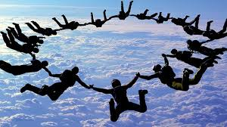
Norms of Collaboration
1. Pausing
2. Paraphrasing
3. Posing
Questions
4. Putting Ideas on
the Table
5. Providing Data
6. Paying Attention
to Self and Others
7. Presuming
Positive Intentions
© Center for Adaptive Schools

Slide 4

We are Glad You are Here
Candi Rumsey, KDE Science Instructional Specialist
Christine Duke, KDE Science Consultant
Mindy Curless, KDE Science/STEM Consultant
Dr. Tom Tretter, University of Louisville
Nikkol Bauer, Henry County

Slide 5


Today’s Work
Analyze assessment tasks
Analyze student work
Generate “student work” for analysis of investigation plan
Use ES Templates to analyze your student work
Phenomenon Discussion
Reflect on experiences through the lens of CHETL,EQUIP, and FfT
Time for collaboration

Slide 6
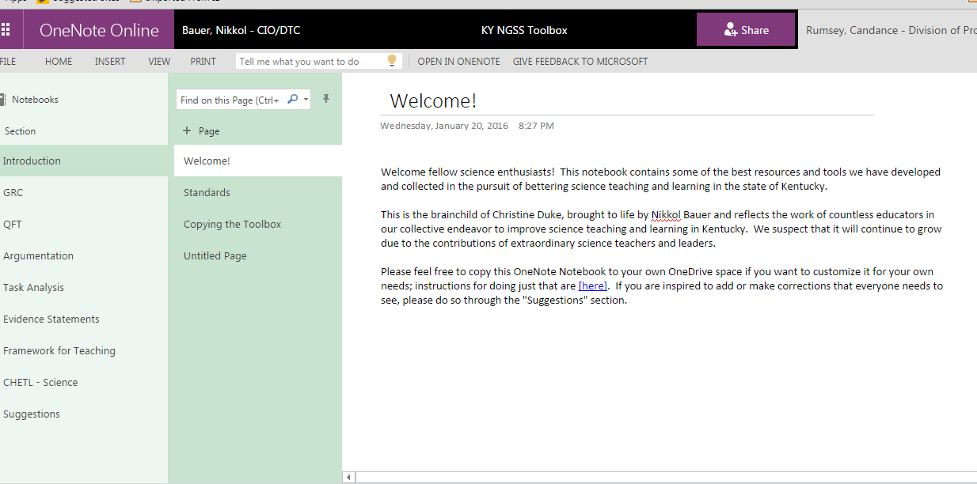
STLN Online Tool Box

Slide 7
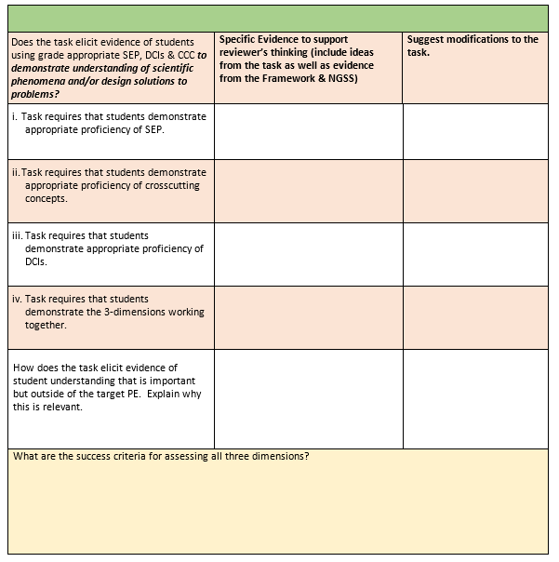
Working in grade band groups of 3

Slide 8
Let’s Reflect
What generalizations can you make?
What did you learn?
What revisions were necessary?
Insights gained?
Other ?

Slide 9


Slide 10
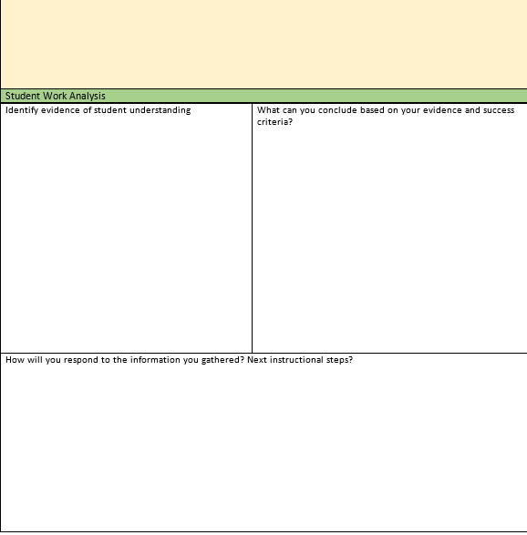
Working in grade band groups of 3

Slide 11
Let’s Reflect
What generalizations can you make?
What did you learn?
What revisions were necessary?
Insights gained?
Other ?

Slide 12


Slide 13
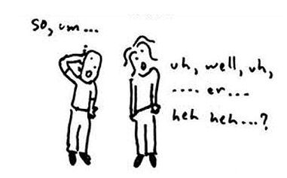
Phenomena
Notes:
"Phenomena" are real-world objects, systems, and events that provide evidence of key ideas in science. A phenomenon may be experienced first hand or vicariously. http://prisms.mmsa.org/

Slide 14
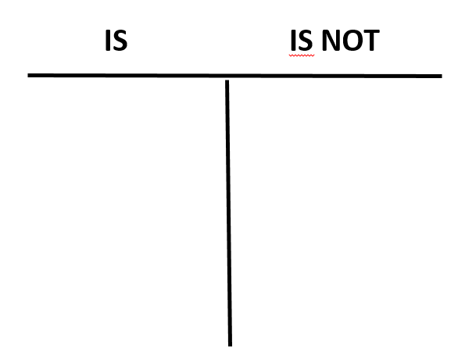
Card Sort
Consider if each card represents a phenomena. Discuss why or why not with your table group.

Slide 15
Characteristics of a phenomenon
Uniqueness of experience
Perception
Something out of the ordinary
Student inspired
Sparks curiosity
A natural event that occurs because of a process or system bound by scientific explanation
A thing or an occurance
Not based on theology- beyond the science
Connected to bigger science concepts
Something that causes you to question
Something observed

Slide 16
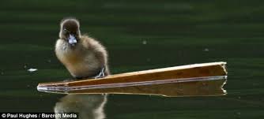

Slide 17
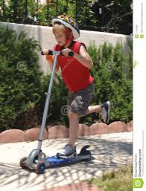

Slide 18
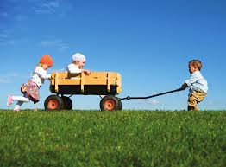

Slide 19
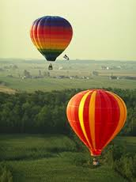

Slide 20
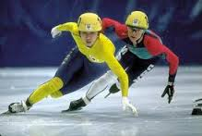

Slide 21
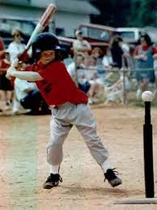

Slide 22
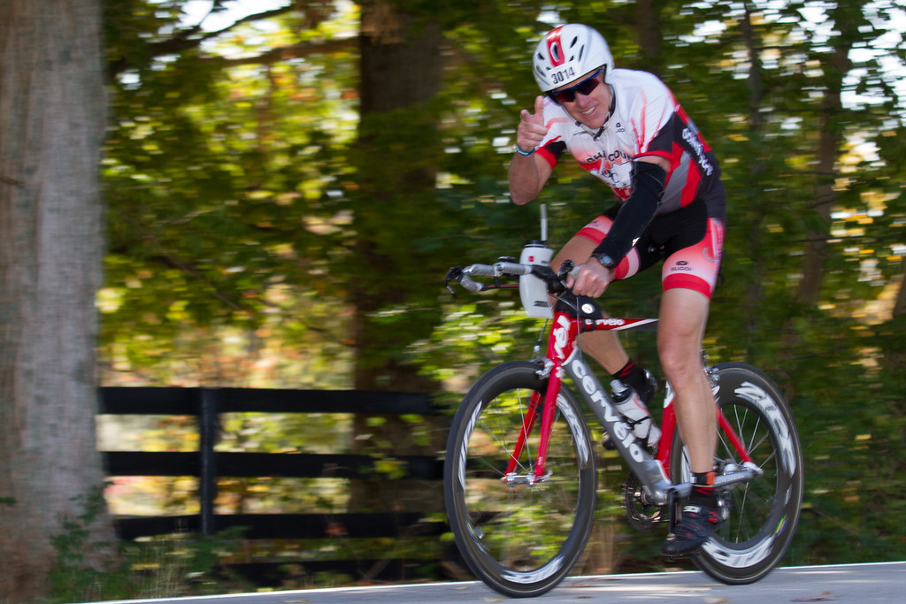

Slide 23
Why do some things float and others sink?

Slide 24

Why do some things float and others sink?
Time to Observe
What items (variables) were the same in your observation? Different? What do you not know? How did the ice float???? Did it sink slightly into the fluid or float completely on the surface???
Notes:
Place the cubes in the fluid filled beakers allow close-up examination

Slide 25
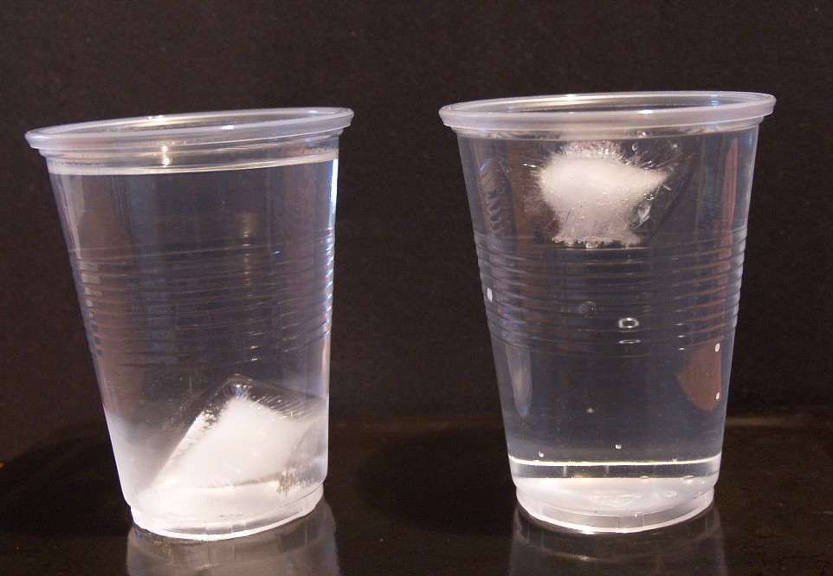
What do you see???
Notes:
Pause on this slide while TLs complete their observation.

Slide 26
Group Discussion
Observations What exactly did we see, hear, smell, feel, or taste? | Inferences What can we infer or presume from our observation? | Questions What questions does this observation generate?
Notes:
Protocol for discussing observations. What inferences can we make? What are the questions that were generated? Summarize large group discussion on post-it charts.

Slide 27
Journal Questions
FA: Thinking questions: Designed to uncover misconceptions and provide insight into student reasoning.
    What happened to the fluid level when the ice was added? Why?
    Did the amount of fluid change when the ice was added to the fluid? Explain your reasoning.
    Imagine the beaker was completely full of liquid and a cube of ice was then added. Describe what would happen.
Notes:
These Journal questions will be addressed as small group discussion questions to expedite the process. Use research materials to assist with answers.

Slide 28
Force Diagrams
Are forces balanced in both scenarios?
Notes:
Up force is Buoyant Force Down is Weight. Equal in A. Weight is bigger in B

Slide 29
Stating Reasons
Using the force diagrams for reference, explain the possible reasons that the ice did not float in the second beaker?
Construct your reasons using evidence from the force diagrams ONLY.
Thinking questions: You may not be able to answer these yet….
    What is another name for the force called Ice?
    What is another name for the force called Fluid?
Notes:
Reach a consensus with the group: There was not enough Buoyant force to oppose the weight of the ice in the second beaker….. QQQQQ>>>>WHY? What causes buoyant force? What is Buoyant force? How is it calculated? What is needed for the calculation? What is Density? How is it Calculated?..........All answered from research. Revisit questions after research.

Slide 30
Time for Research
Understanding why some things float and others sink will require students to research this topic. Topics for research might include “Buoyancy and Archimedes’ Principle, How does ice float?” or When does ice sink?”. Teachers may steer research using these criteria or allow students to generate research ideas on their own if time is not an issue.
Notes:
Steering discussion with “hot topics” is very useful to expedite facilitation but may lessen to value of the learning. Why?

Slide 31
Research Resources
Notes:
Examples of research/reading are given in packets.

Slide 32
More Resources
https://www.youtube.com/watch?v=RyYt4U-phh0
https://www.youtube.com/watch?v=nMlXU97E-uQ
https://www.youtube.com/watch?v=w92H76E_gng
Notes:
Show the bowling ball demonstration in Lab.. Bowling balls all don’t all float.
PLEASE NOTE: Some bowling balls float, and some sink. The low weight balls (including the 12 lb ball at a density of 999.6 kg/m³) all float. Only the 14 lb and 16 lb balls will sink

Slide 33
Collaborative Research
Brainstorm with your lab partners and/or perform research for answers to why things float and sink.
Buoyancy, and/or Archimedes Principle are good starting points
    After performing the research/reading, you may revise your possible reasons in number 3 and answer:
    What is another name for the force called Ice?
    What is another name for the force called Fluid?
Notes:
Give time for research and discussion of these questions. 10 minutes

Slide 34
Making the Plan
Together, you and your lab partners will develop a plan to accurately and precisely collect the data needed to support your reasoning.
As you answer questions (4,5,& 6) refer to the rubric for planning investigations.
FA: Thinking questions: Check for Understanding From Previous work
    What does it mean to measure accurately?
    What does it mean to measure precisely?
Notes:
Give the TLs rubric for planning investigation. Use the rubric to steer answers. Give minimal assistance…….

Slide 35
Looking at the Work
With a partner, use the rubric for Planning an Investigation to analyze the work for congruency to this practice.
Make notes about areas where the work falls short of proficiency (3) on the rubric.
  Give evidence why the work fell short of proficiency
  Give feedback as to what the work needed to reach proficiency
Notes:
Make sure evidence is provided along with proper feedback. Need to be at a 3

Slide 36
Reflecting on the Lesson
Large group discussion:
  Were there any groups that differed in what they were investigating?
  Did we find multiple methods for planning the same investigation?
  What was missing in the lesson that would allow students to demonstrate the practice of planning an investigation?
Notes:
Is it possible to investigate different items and reach the same outcome? What does this tell us about our lesson? What would you do differently to make it work for your grade level? Hallie

Slide 37
Modeling and Guided Practice
Read the document you were given. Understand what you are specifically looking for during the learning experience that you are about to observe.
Make sure to take good enough notes to be able to justify what you scored the “lesson” on CHETL and Framework Crosswalk .
Notes:
Hallie

Slide 38
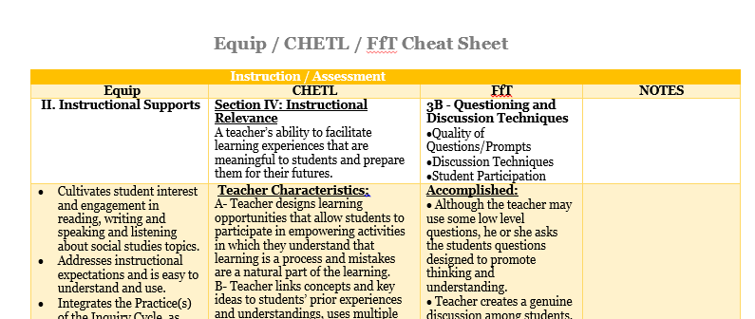
CHETL and FfT Connections

Slide 39

Analyzing the experience using Fft, Equip and CHETL combined document
Highlight evidence found in the combined document
Choose one to use
Notes:
Should we have different teachers look at one of the 3 documents rather than each one? Perhaps different table groups could be assigned a different doc? They could capture their analysis by highlighting the positives aspects of the lesson and striking those that stood out as needing revision? See the following two slides for a different idea.

Slide 40
Analyze artifacts (products & practices) for congruency of standards/ assessments/ instruction using appropriate tools
Using the Crosswalk tool:
  Individually first:
    Use your notes and comments to attach the defensible statements to the crosswalk tool to defend your score for each part of the document
    In your small groups discuss your findings – be ready to discuss and note the findings that were different among the group and similar.
    Give at least one suggestion to the teacher on how to improve the lesson.
Notes:
Hallie

Slide 41
Modification
Based on discussions and what other groups have come up with as suggestions (not being the be all end all)
How would you modify the density lesson based upon artifact analysis, rubric discussion and the CHETL characteristics?
  You will have 10 minutes to ponder and alter – be ready to share.
Notes:
Hallie

Slide 42
Goal for working groups
Determine phenomenon or begin with selected PE(s)
Identify learning outcomes (what tools will you use?)
Decide how students will show what they know?
Create proficiency statements around standards (not the task!)

Slide 43

Please Complete Your Evaluation

